Slide 1



4th Tango Kernel Webinar
PyTango
Overview and how to contribute
Anton Joubert - NRF/SARAO
Geoff Mant - STFC
23 June 2021

Slide 2
Agenda
Introduction
Repository overview
Dependencies
How to: set up a dev environment, run the tests, add a new test
Architecture overview
Practical example: code navigation while reading an attribute
Useful tips
Contribution workflow
Questions

Slide 3
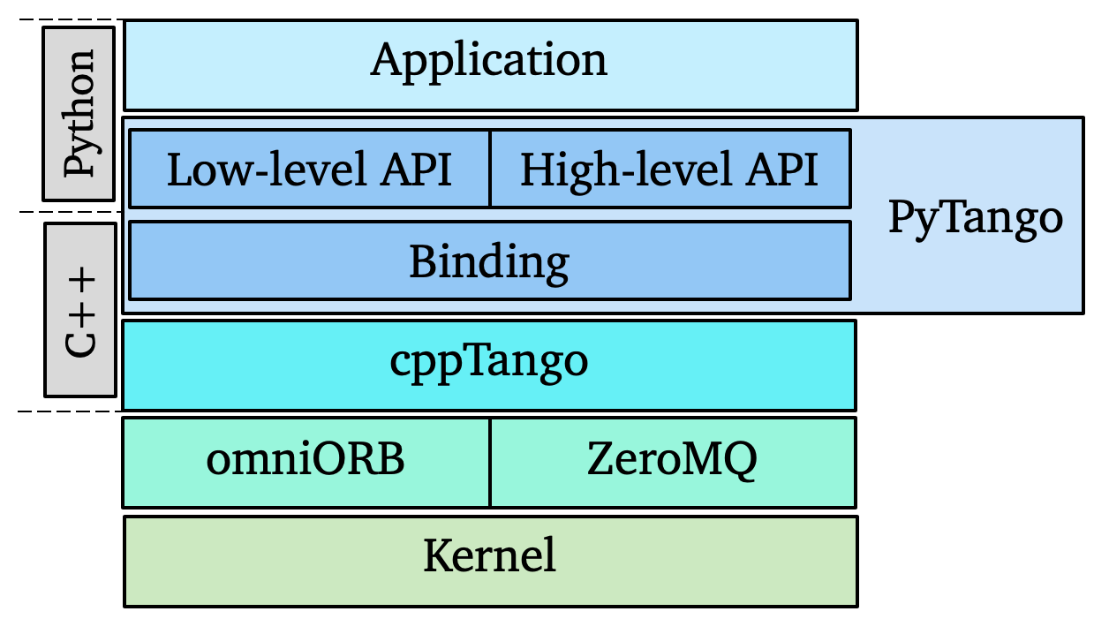
Introduction
Python library
Binding over the C++ tango library
... using boost-python (future: pybind11)
Does not use omniorb Python library
Relies on numpy
Multi OS: Linux, Windows, MacOS (sort-of)
Works on Python 2.7, 3.5+

Slide 4
Introduction
< 2003 ? | Project started at SOLEIL
2005 | Moved to ALBA. M. Taurel develops server.
2006 | T. Coutinho main contributor.
2010 | First package on pypi.org.
2012 | High-level server API.
2013 | Project moves with T. Coutinho to the ESRF.
2015 | Included as Debian 8 package.
2016 | PyTango 9 is released. V. Michel joins as maintainer.
2017 | Welcome to Solaris.
2018 | Welcome to SKA and institutes working on that project.
2019 | A. Joubert joins as maintainer.
2021 | Conda package on conda-forge (previously tango-controls).
* Welcome to all institutes, even if not mentioned!
Notes:
Mention of Python support in 2003: http://accelconf.web.cern.ch/ica03/PAPERS/MP705.PDF
History up to 2017 from https://vxgmichel.github.io/icalepcs-workshop/#30

Slide 5
Introduction
Original goal:
Provide a Python wrapper around the cppTango library
This resulted in the “low-level” Python API, closely matching cpp code.
Later:
Provide a Pythonic way of using Tango
This resulted in the “high-level” Python API, much nicer for Python programmers

Slide 6
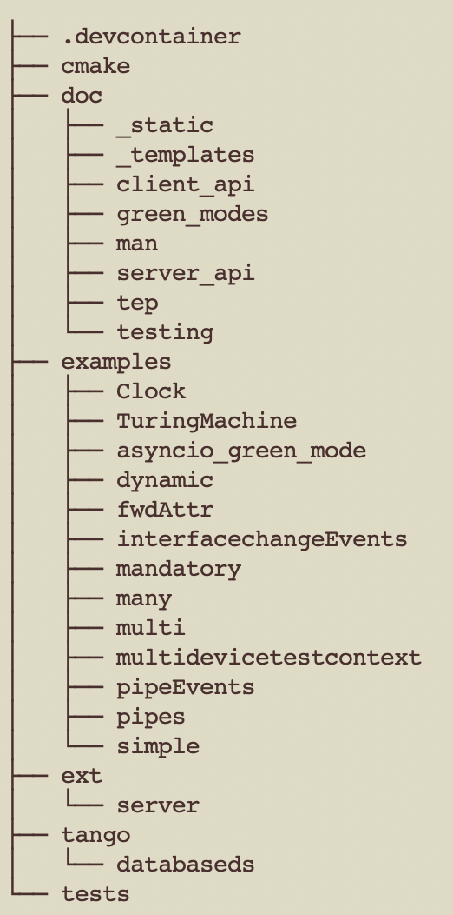
Repository overview
Root has usual suspects: setup.py, CI yaml, license, etc.
Docker container for developers, editor configs, etc.
Cmake utilities (used for Windows compilation)
Sphinx docs
PyTango Extension Proposals (a bit like Python PEPs)
Various examples
C++ extension code
Python modules (used to be named PyTango)
Old Python-based DatabaseDS
Unit tests

Slide 7
Dependencies
OS dependencies:
libtango >= 9.3, and its dependencies: omniORB4 and libzmq
Boost.Python >= 1.33
Python dependencies:
numpy >= 1.1
six >= 1.10
Build dependencies:
Setuptools
Sphinx
Optional dependencies:
futures
gevent

Slide 8
How to set up a dev environment?
Clone the repo (or your fork)
 | git clone git@gitlab.com:tango-controls/pytango.git
Build a dev docker image in the .devcontainer folder (readme)
 | cd .devcontainer export PYTHON_VERSION=3.8 TANGO_VERSION=9.3.4 docker build . -t pytango-dev:py${PYTHON_VERSION}-tango${TANGO_VERSION} \ --build-arg PYTHON_VERSION --build-arg TANGO_VERSION
Run docker container, bind mount your source as a volume
 | docker run -it --rm --name pytango-dev -v ~/tango-src/pytango:/opt/pytango \ pytango-dev:py3.8-tango9.3.4 /bin/bash
Inside the container build the extension, optionally run tests
 | cd /opt/pytango python setup.py build python setup.py test

Slide 9
How to set up a dev environment?
If you want to run PyTango scripts, pytest, or use from a Python session:
Configure your IDE:
PyCharm (professional)
VS Code (remote containers extension)
Details in the readme
cd /opt/pytango
pip install -e .

Slide 10
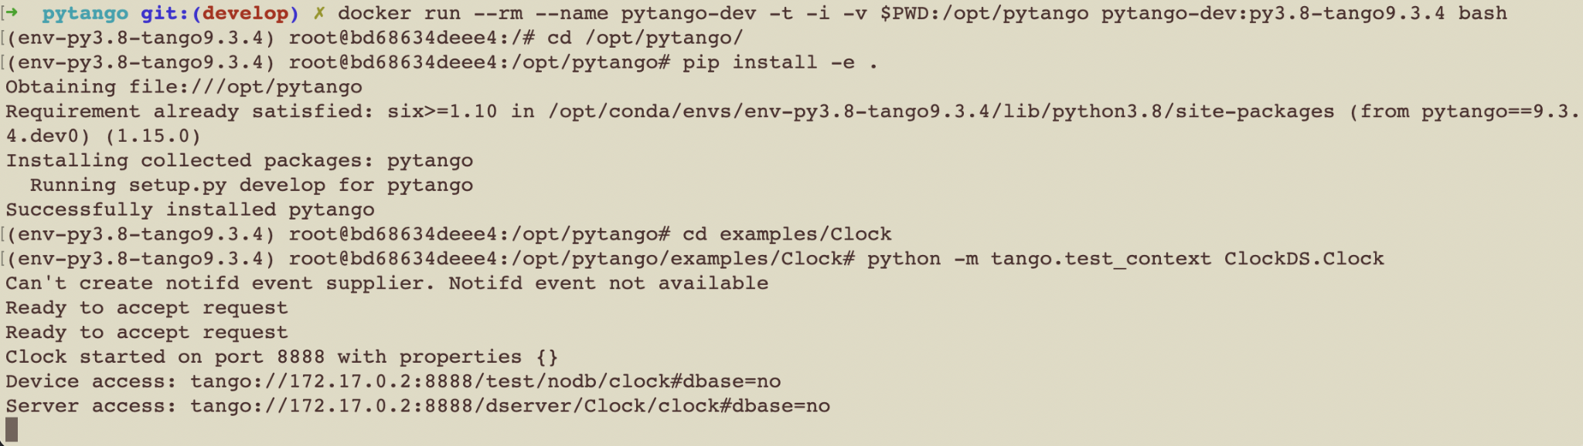
How to set up a dev environment?
Running the example Clock device server in the container
Two of these means cppTango debug compilation

Slide 11
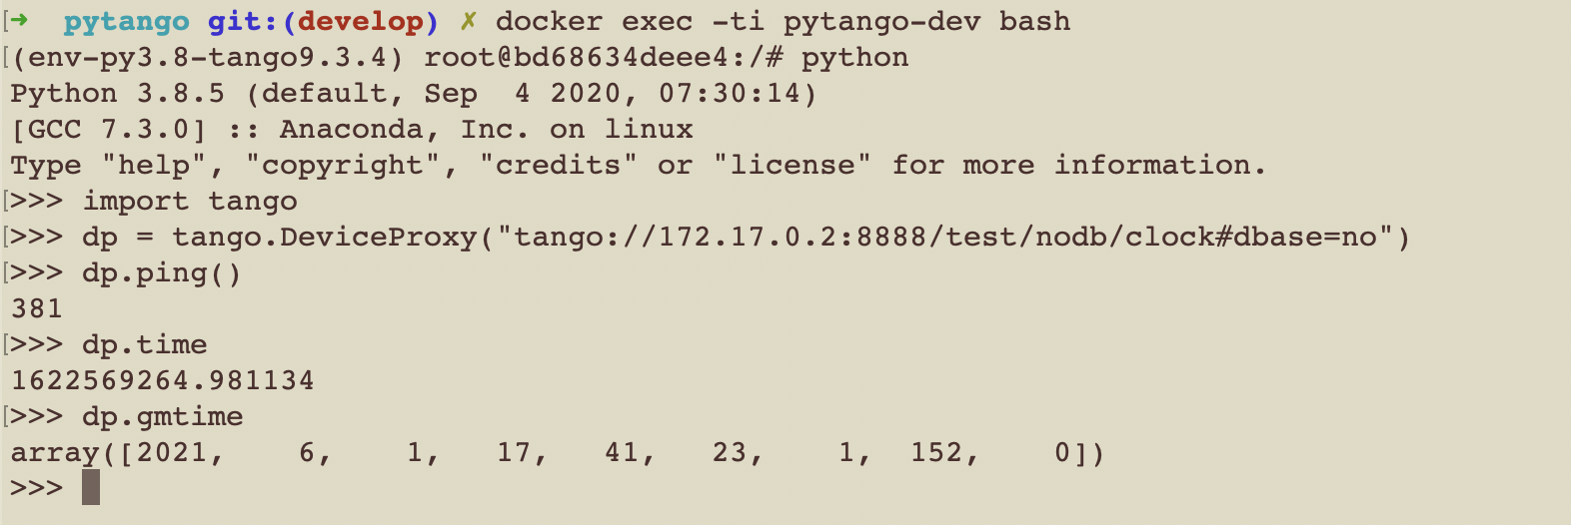
How to set up a dev environment?
Connect to the example Clock device from another container shell

Slide 12
How to run the tests?
Run full test suite (pip install required)
 | pytest
Run a single test
 | pytest -k test_async_command_polled[int]
Run a test and enter PDB on the first failure
 | pytest -k test_async_command_polled[int] --pdb

Slide 13
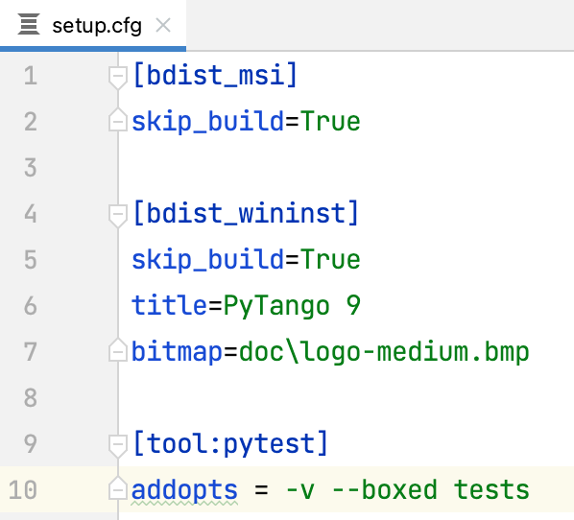
How to run the tests?
If running individual tests from PyCharm we need to
edit setup.cfg:
remove tests from pytest options, so not
all tests are run.
The --boxed option runs each test in a new process
as the DeviceTestContext can only be used once
Note: the --boxed option is not supported on Windows
Notes:
--boxed same as --forked. From pytest-xdist?

Slide 14
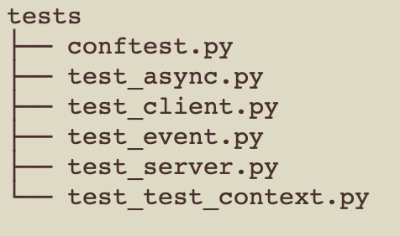
How to add a new test?
Pick the right file, or add a new one (test_something.py)
pytest setup
command_inout_asynch tests
DeviceProxy tests (mostly using TangoTest device)
Event subscription tests
Device tests
DeviceTestContext tests

Slide 15
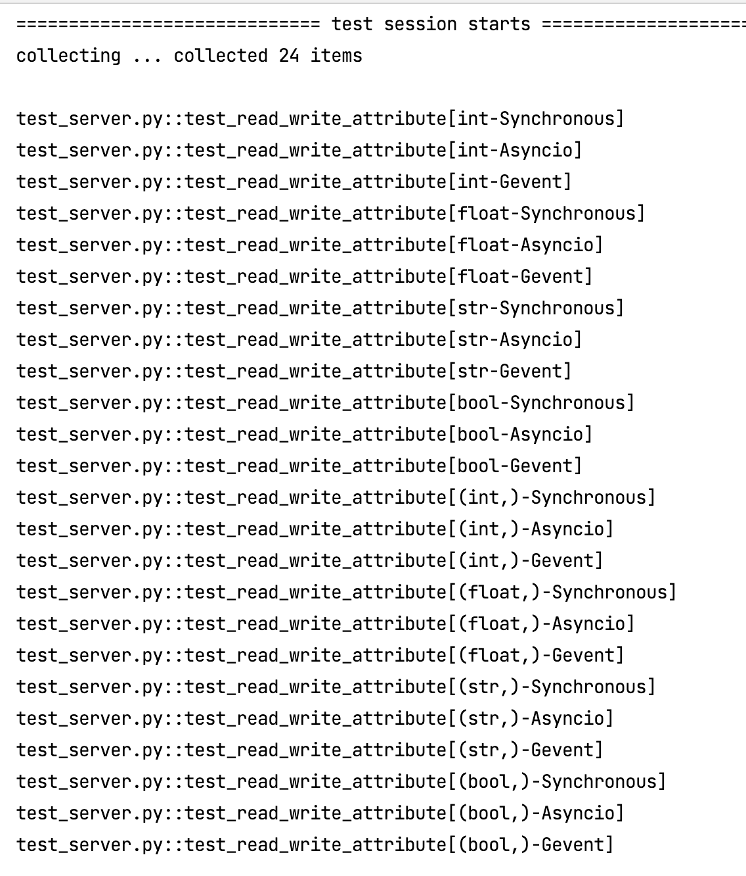
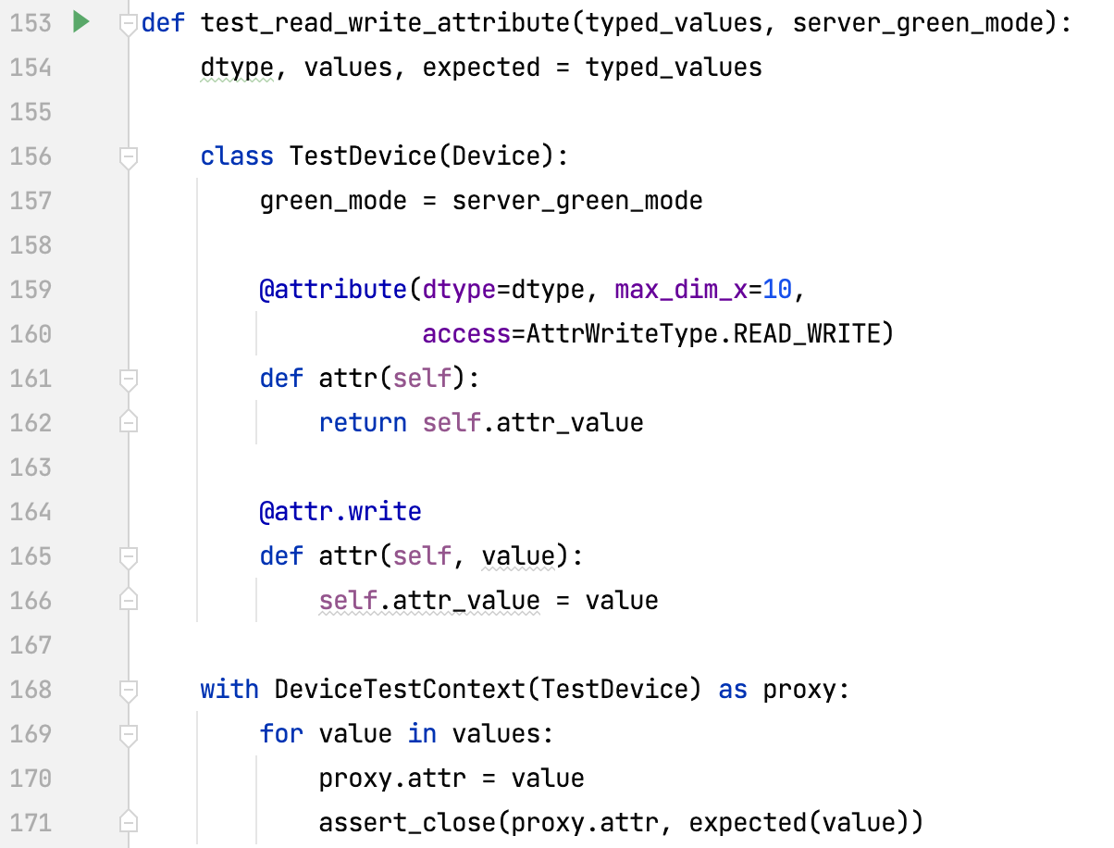
How to add a new test?
Find a similar test and copy the pattern (keep related tests together)
Use existing fixtures to cover many variants easily

Slide 16
Architecture overview

Slide 17
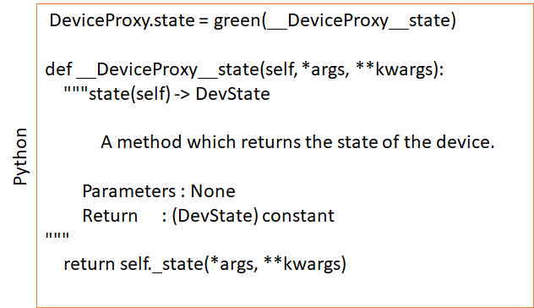
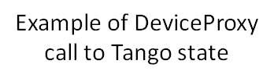
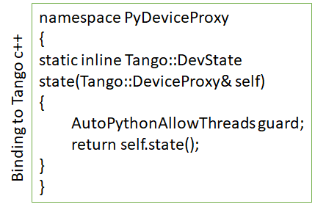
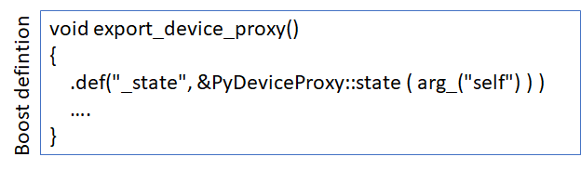

Slide 18

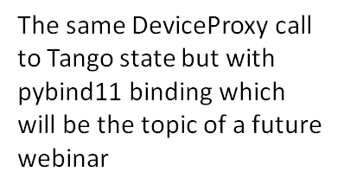
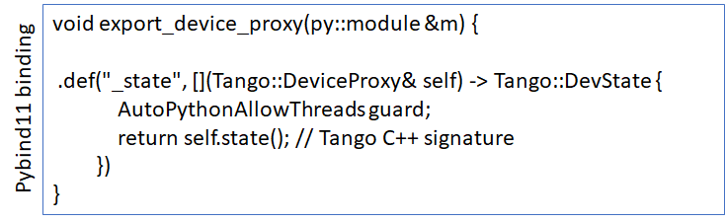

Slide 19
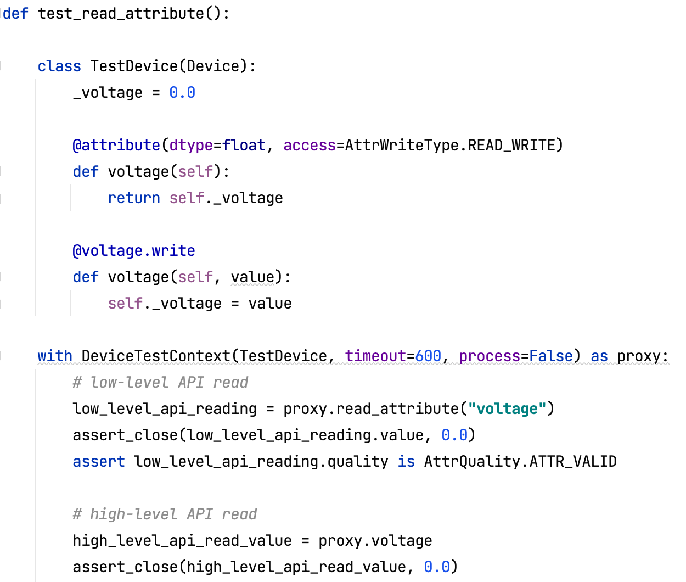
Practical example: Code navigation.
What happens when an attribute is read?
Client side: DeviceProxy
Server side: Device
Notes:
Source:
from tango import AttrQuality, AttrWriteType, GreenMode
from tango.server import Device, attribute
from tango.test_utils import DeviceTestContext, assert_close
def test_read_attribute():
class TestDevice(Device):
_voltage = 0.0
@attribute(dtype=float, access=AttrWriteType.READ_WRITE)
def voltage(self):
return self._voltage
@voltage.write
def voltage(self, value):
self._voltage = value
with DeviceTestContext(TestDevice) as proxy:
# low-level API read
low_level_api_reading = proxy.read_attribute("voltage")
assert_close(low_level_api_reading.value, 0.0)
assert low_level_api_reading.quality is AttrQuality.ATTR_VALID
# high-level API read
high_level_api_read_value = proxy.voltage
assert_close(high_level_api_read_value, 0.0)
# low-level API write
value = 24.0
proxy.write_attribute("voltage", value)
high_level_api_read_value = proxy.voltage
assert_close(high_level_api_read_value, value)
# high-level API write
value = 48.0
proxy.voltage = value
high_level_api_read_value = proxy.voltage
assert_close(high_level_api_read_value, value)
def test_read_attribute_full():
class TestDevice(Device):
green_mode = GreenMode.Synchronous
def __init__(self, *args, **kwargs):
super().__init__(*args, **kwargs)
self._voltage = 0.0
def init_device(self):
super().init_device()
print("init_device!")
def read_attr_hardware(self, attr_list):
print(f"read_attr_hardware for {attr_list}")
def write_attr_hardware(self, attr_list):
print(f"write_attr_hardware for {attr_list}")
def always_executed_hook(self):
print("always_executed_hook")
@attribute(dtype=float, access=AttrWriteType.READ_WRITE)
def voltage(self):
return self._voltage
@voltage.write
def voltage(self, value):
self._voltage = value
def is_voltage_allowed(self, req_type):
return True
@attribute(dtype=float, access=AttrWriteType.READ)
def current(self):
return self._voltage / 2.0
with DeviceTestContext(TestDevice, timeout=600, process=False) as proxy:
# low-level API read single
low_level_api_reading = proxy.read_attribute("voltage")
assert_close(low_level_api_reading.value, 0.0)
assert low_level_api_reading.quality is AttrQuality.ATTR_VALID
# low-level API read multiple
low_level_api_readings = proxy.read_attributes(["voltage", "current"])
assert_close(low_level_api_readings[0].value, 0.0)
assert low_level_api_readings[0].quality is AttrQuality.ATTR_VALID
# high-level API read
high_level_api_read_value = proxy.voltage
assert_close(high_level_api_read_value, 0.0)
# low-level API write
value = 24.0
proxy.write_attribute("voltage", value)
high_level_api_read_value = proxy.voltage
assert_close(high_level_api_read_value, value)
# high-level API write
value = 48.0
proxy.voltage = value
high_level_api_read_value = proxy.voltage
assert_close(high_level_api_read_value, value)

Slide 20
Useful tips - compiling the extension
Compiling the extension
C++ files in ext/ create _tango shared library
Example: build/lib.linux-x86_64-3.8/tango/_tango.cpython-38-x86_64-linux-gnu.so
Triggered by python setup.py build , pip install , etc.
Environments vars used by compilation (in setup.py):
TANGO_ROOT, OMNI_ROOT, ZMQ_ROOT, BOOST_ROOT
Point to installation folders of these packages, e.g., we use $CONDA_PREFIX in CI.
Boost can be tweaked more: BOOST_HEADERS, BOOST_LIBRARIES, BOOST_PYTHON_LIB

Slide 21
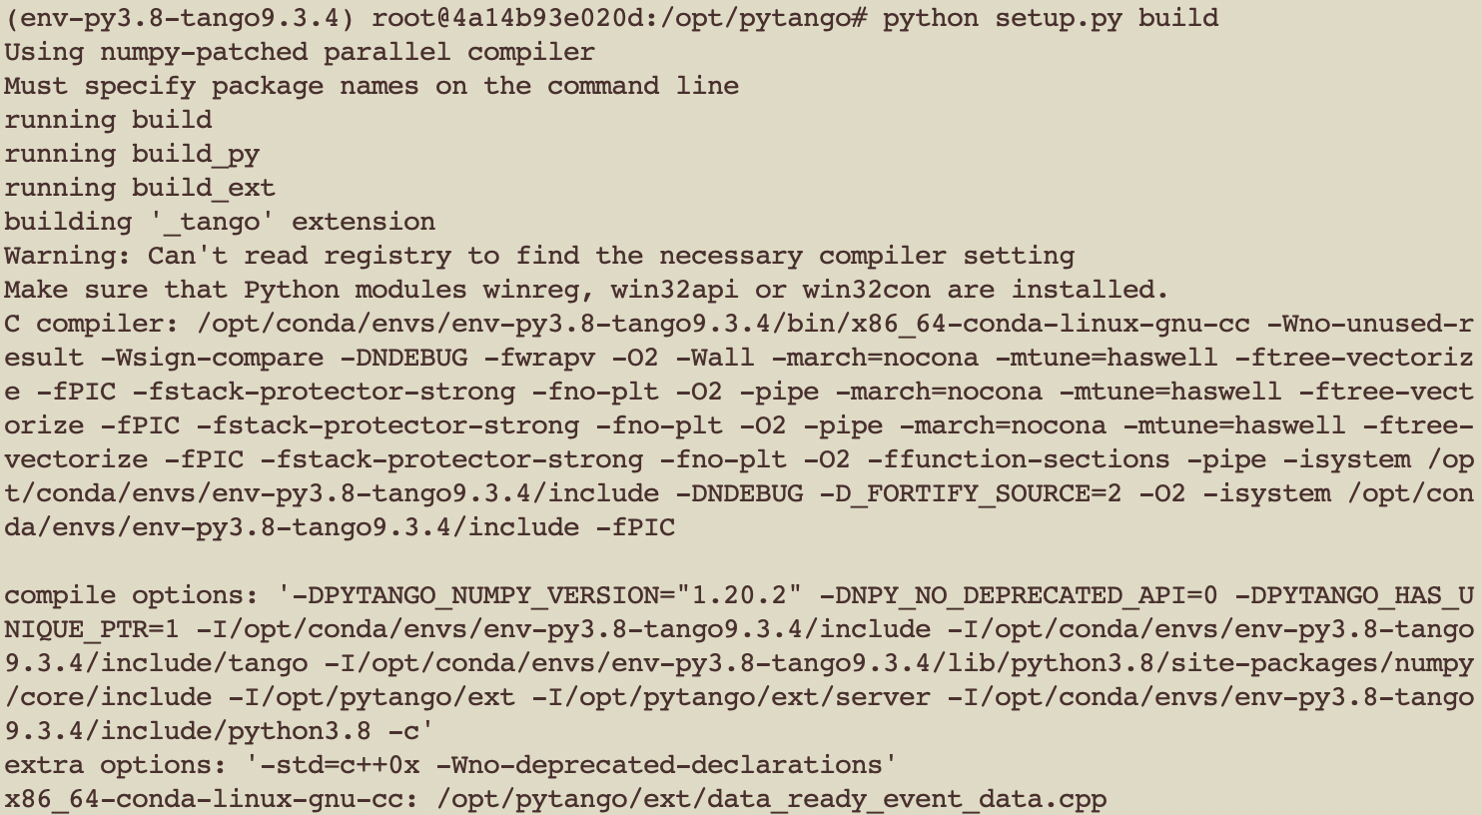
Useful tips - compilation shortcuts
If the ext/ files haven’t changed, and _tango file exists can skip compilation:
touch build/lib.linux-x86_64-3.8/tango/_tango.cpython-38-x86_64-linux-gnu.so
Makefile? Not used. Is it up to date? Is being used for pybind11 work.
If working on .cpp file in the extension code,
full compilation is slow. Shortcut:
Compile the single .cpp file
Use command from previous build
Specify .cpp file after the -c option
Add -o with name of .o file.
Link the _tango file again

Slide 22
Useful tips - crash reports
Run a new Docker image (or from your own environment)
 | docker run --rm -ti -v $PWD:/opt/pytango continuumio/miniconda3:4.9.2 bash
Install PyTango, cppTango+debug symbols, GDB (if necessary)
 | conda create --yes --name env --python=3.8 && conda activate env conda install -c conda-forge pytango cpptango-dbg apt update && apt install gdb
Run the script that crashes through GDB
 | gdb --args python /opt/pytango/my_script.py (gdb) run ... Thread 1 "python" received signal SIGSEGV, Segmentation fault. 0x00007f97c550cb78 in Tango::EventConsumer::unsubscribe_event (this=0x56450a640a20, event_id=1) at /usr/local/src/conda/cpptango-9.3.4/cppapi/client/event.cpp:2028 (gdb) bt

Slide 23




Contribution workflow
Discuss ideas in GitLab issues
contributors
maintainers
fork develop*
create MR
Discuss and commit changes on MR
commit changes to MR
check and propose changes
automated tests
merge MR to develop*
Diagram credit: https://github.com/sardana-org/sardana-training/tree/master/developers
* develop branch to be renamed main, to match cpptango

Slide 24
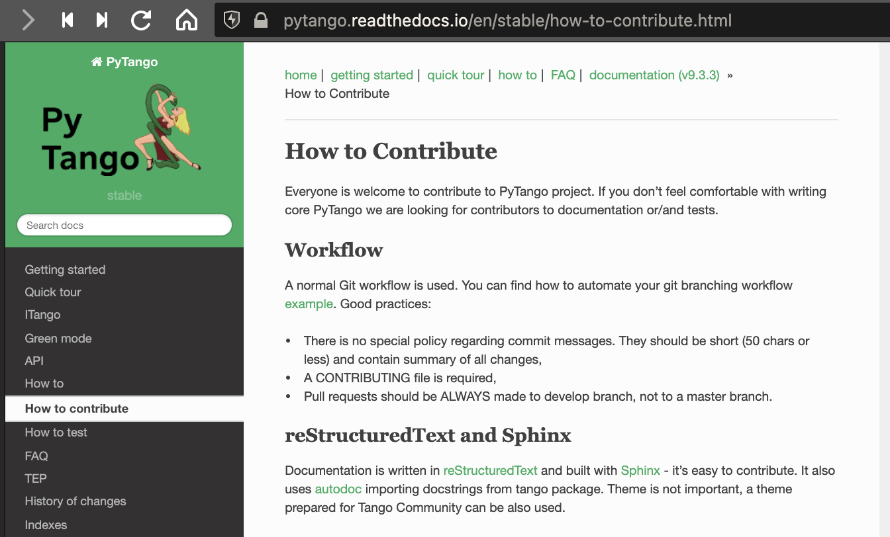
Contribution workflow
More details in the online docs:
https://pytango.readthedocs.io/en/stable/how-to-contribute.html

Slide 25
Thank you!
Any questions?
https://gitlab.com/tango-controls/pytango

