Slide 1

Starter / Astor
A couple to dance the
TANGO
http://www.tango-controls.org/
EUROPEAN SYNCHROTRON RADIATION FACILITY

Slide 2
Starter and Astor
Starter
  Introduction
  States
  Commands
  Attributes
  How a server registers on a host
  Startup phase
  The UpdateServerInfo command
  The Starter device name
  Server control
  Stater files
Astor
  Introduction
  Startup
  States colors
  Astor configuration
    Additional HTML pages
    Start servers at startup
    Additional Java tools
  Server attribute polling
  Server statistics
  Astor features overview

Slide 3
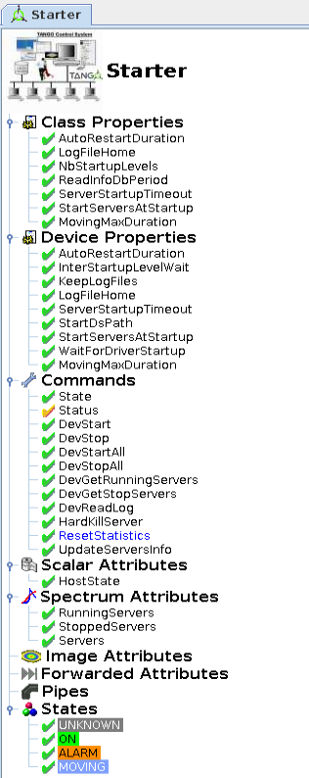
Starter C++ TANGO device
Introduction:
  The Starter is a C++ TANGO device server like another one.
  There is nothing specific (except a feature in Database device)
  It has been started to be written in 2000 using C++98 and first TANGO prototype:
  no guide lines
  state/status not attributes
  no polling
  no events
  attributes were not a class
  …
  Threads are omni_thread objects protected by TangoMonitor objects
  few commands and attributes are still present for backward compatibility
  Servers are managed on different control levels.
  The default level number is 5
  It could be modified using class property NbStartupLevels
  we use 8 levels at ESRF

Slide 4
Starter C++ TANGO device
States:
  ON: All controlled servers are running and all admin devices are responding
  MOVING: At least one controlled admin device is not responding
  Server starting ? Device blocked ?
  STANDBY: At least one admin device is not responding since a while.
  This time is defined by MovingMaxDuration property (default 120s)
  ALARM: At least one controlled server is not running
  OFF: All servers are stopped
  UNKNOWN: Starter had a problem at startup

Slide 5
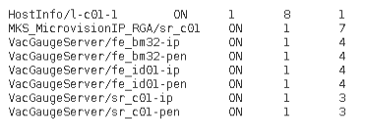
Starter C++ TANGO device
Commands:
  DevStart: start specified server
  DevStop: stop specified server
  DevStartAll: start all servers for specified level
  DevStopAll: stop all servers for specified level
  DevReadLog: return starter logs (start/stop) for specified server
  HardKillSever: stop a server using kill -9
  UpdateServerInfo: query database to update server list with their control level
  ResetStatistics: reset the Starter statistics (Expert level)
Attributes:
  Servers: a string spectrum containing for each server:
    Server name
    Server state
    Controlled
    Control level
    Nb instances only if more than 1

Slide 6
Starter C++ TANGO device
Reminder: How a server registers on a host ?
  When a server start on a host it exports all device IORs on TANGO database to be imported by clients
  It updates (or creates if first time) a row in server database table containing:
    The Server name
    The host where it runs
    If controlled or not
    The startup level
  This information will be used later by the Starter using database device command DbGetHostServersInfo
  to control each server running on the host

Slide 7
Starter C++ TANGO device
Starter startup phase:
  If the database server does not run, it loops until the database answer
  It gets the server list, registered for the specified host, with their controlled info using DbGetHostServersInfo database command.
  It builds a vector of ControlledServer objects.
  If the class property StartServersAtStartup is true (default case), it starts each controlled server in ascending level number order. In a level, the alphabetical order is used.
  The fork process is executed in a dedicated thread (StartProcessThread)
The fork server phase:
  Fork the server in a thread (StartProcessThread)
  Wait to find it in process table (/proc under linux)
  Wait admin device responding or end of timeout fixed by ServerStartupTimout property
  (default 1s. 4s at ESRF)
  Can start next server.

Slide 8
Starter C++ TANGO device
The UpdateServerInfo command:
It must be executed:
  At Starter startup
  When a new server is registered on the host
  When a server registered on the host starts on another host
  When a control level changes for a registered server
All starters cannot poll the Database server to know if something has changed.
It would be very heavy in a large control system.
When an action on Database corresponding to 2, 3 and 4 a little thread of the database device is activated to execute UpdateServerInfo command on Starter on affected host(s)

Slide 9

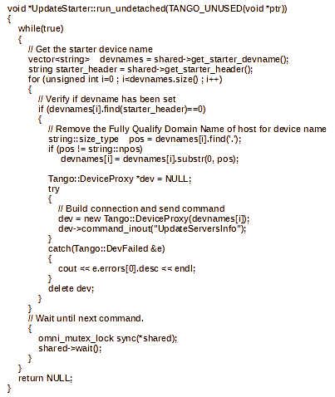
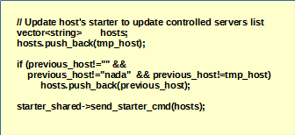
Starter C++ TANGO device
When an action on Database device corresponding to 2, 3 or 4 a small thread is activated

Slide 10
Starter C++ TANGO device
The Starter device name:
By convention, it has been decided that Starter device name is:
tango/admin/<host name> (host name without FQDN)
At ESRF when we rebuild completely our database for EBS, we would like to change the Starter device domain name to sys
To keep the backward compatibility we add a Starter class property Domain
The device name become for the complete control system:
sys/admin/<host name>

Slide 11
Starter C++ TANGO device
Server control:
  A thread read the processes running on the host and gets PID and command line every 2 s using
    /proc directory under Linux
    Windows system calls
  It parse the command lines to search the controlled processes
    Starting with process and instance names for C++ processes
    If start with java or python check process and instance names after
  If the process is not found, the process object is set FAULT
  If the process is found, the admin device (dserver/<server name>/<host name>) is pinged
    If ping failed, the process object is set MOVING
    If ping answers, the process is set ON

Slide 12
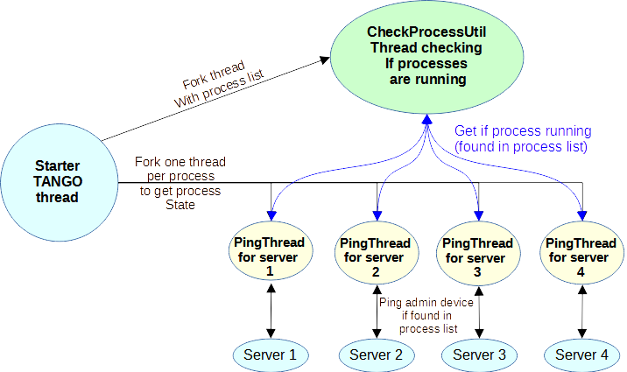
Starter C++ TANGO device
Server control:

Slide 13
Starter C++ TANGO device
Starter source files:
  ClassFactory.cpp and main.cpp as other TANGO server
  StarterStateMachine.cpp as other TANGO device
  Starter.cpp and Starter.h Starter TANGO device class
  StarterClass.cpp and StarterClass.h Starter TANGO device management class
  StarterUtil.cpp and StarterUtil.h a set of utilities used by Starter device
  PingThread.cpp and PingThread.h a thread to ping admin device of specified controlled server
  CheckProcessUtil.cpp and CheckProcessUtil.h a thread to check the running process list
  StartProcessThread.cpp a thread to start process(es)
  StarterService.cpp and StarterService.h used to create a Windows service.
https://github.com/tango-controls/starter

Slide 14
Astor a java client to manage Starters
  Introduction:
  “ASTOR” is a reference to “Astor Piazzolla” a famous Tango player
  Astor is a GUI, Java client in charge to manage all Starters registered in a control system
  It has been started to be written in 2000 using java-1.2 and first TANGO prototype:
    Very poor TANGO java API
    Very poor Database device server
    no guide lines
    no events
    …
  Its main frame displays in a tree:
    The TANGO database state
    The TANGO access control state if it has been activated
    A set of branches containing host states
  A dialog window can be opened for each host to display states of all server states registered on this host.
  Astor is a server oriented tool (not a device oriented)

Slide 15
Astor a java client to manage Starters
Astor startup:
  At startup, it gets from the database the list of Starter device names.
  For each device name, the member is the host name.
  A thread is started for each Host. This thread will models the specified host and subscribe to Starter state attribute.
  The main thread reads property HostCollection for all Starter devices (on one call using DbMySqlSelect database command) to sort them by branches.
  Do same thing for property HostUsage to display as comment on tree.
  Then the branches are sorted by alphabetic order to be displayed on tree.
  During this sort, branches marked as last collections (Astor/LastCollections free property) are put at end (see Files/Control System Preferences menu),
  It is very useful for hosts on maintenance or in labs.
Parameter | Mode
-rw or none | Astor is fully READ_WRITE
-db_ro | Astor is READ_WRITE but Database is READ_ONLY
-ro | Astor is fully READ_ONLY

Slide 16
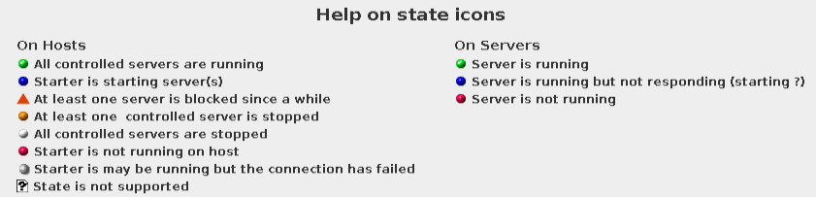
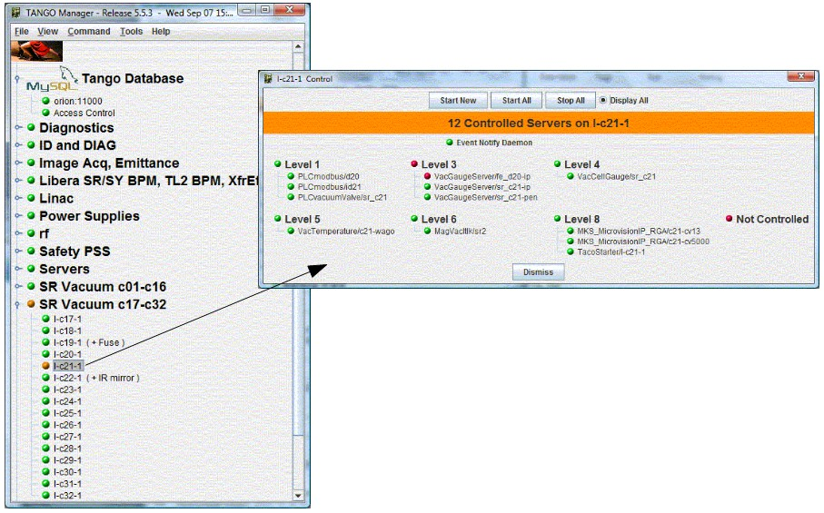
Astor a java client to manage Starters
Astor state colors:
The information can be found using Help/State Icons menu

Slide 17
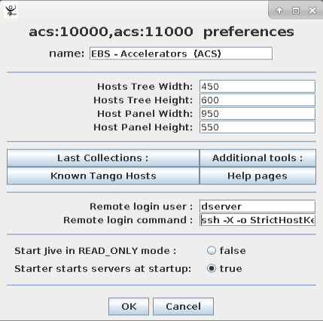
Astor a java client to manage Starters
Astor Configuration:
  To configure Astor use the following window.
  Click on File/Ctrl System Preferences menu to open
  It allows to:
    Define control system name
    Define default tree and server window sizes
    Additional java tools.
    Additional html pages.
    Host remote loggin command and user name.
    Jive in RAD_ONLY mode.
    Starter starts servers at startup
  NOTE: To disable the Preference menu, start Astor with -DNO_PREF=true.

Slide 18
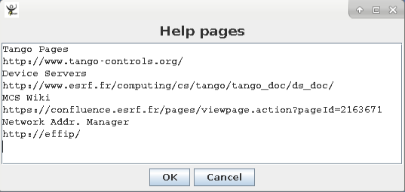
Astor a java client to manage Starters
Astor Configuration:
  Additional html pages:
    The free property Astor/HtmlHelps give the possibility to add specific html pages.
    This is a string array property.
    The first line is the message displayed in help menu.
    The second one is the URL address for the specified page.
  Starter starts servers at startup:
    This boolean property allows the starter to starts the device servers during its startup phase.
    If it is false, when the starter will be started, it will not start any server.
    It could be useful when a large control system is re-started to do not overload the Tango database.

Slide 19
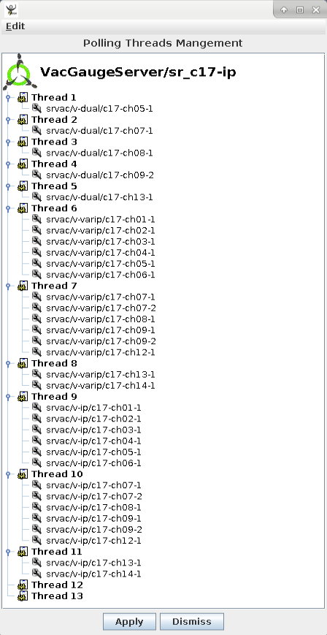
Astor a java client to manage Starters
Attribute polling:
  Pool of polling threads:
    By default, a single thread is started to poll attributes.
    In case of several devices, a pool of threads is available.
    Astor proposes a graphic tool to distribute device(s) by thread:
      Set the expected thread number
      Use drag and drop to configure the pool.

Slide 20
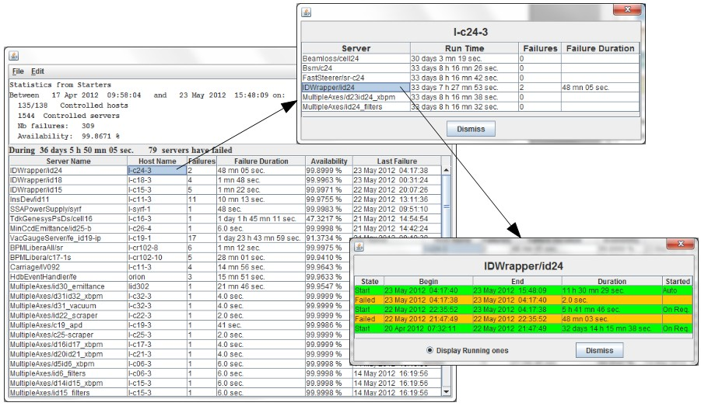
Astor a java client to manage Starters
Server statistics:
  When a server, started by the Starter, is stopped by another way (kill signal, core dump, ...), this event is logged in a file.
  When the server is re started by the Starter, this information is logged too.
  Astor proposes to get information from this file for :
    All controlled hosts
    One host.
  To compute statistics for servers.
  The automatic restart of a server is active only if the server has been running more than specified by the Starter class property AutoRestartDuration (in minutes)
  2 hours at ESRF
  The reset of servers statistics is control system specific. It must be reserved to a TANGO administrator.
  On Astor, it is protected by a password.

Slide 21
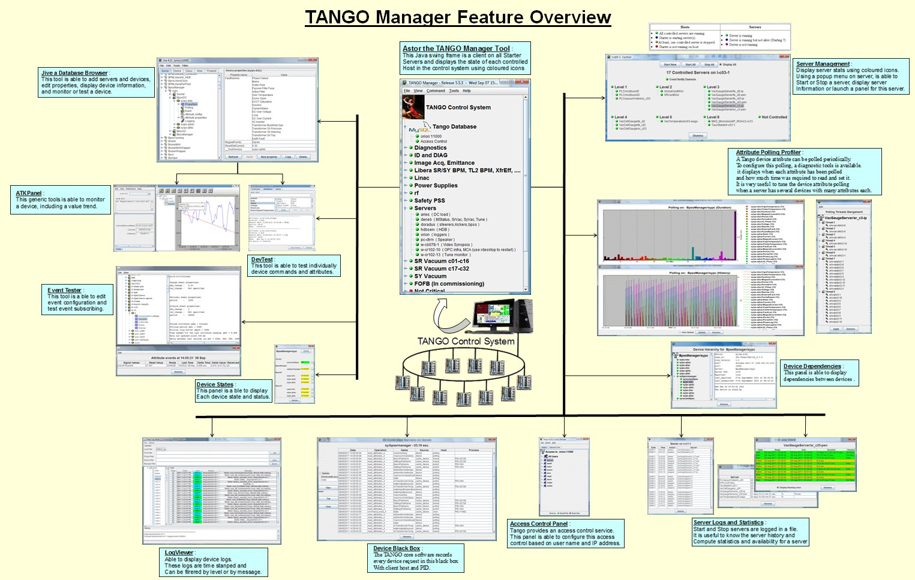
Astor a java client to manage Starters

Slide 22
Thank you!
Questions?

