Slide 1

Pogo
The TANGO device class
code generator
http://www.tango-controls.org/
EUROPEAN SYNCHROTRON RADIATION FACILITY

Slide 2
Pogo TANGO code generator
A programmer point of view. Not a user point of view
Brief history:
  Pogo is a java TANGO device class generator. It is able to generate C++, Java and Python code.
  It has been started to be written in 2000 using its own code parsing until Pogo-6.2.5a
  From Pogo-7.0.0, it has been re written completely with Eclipse plugin OpenArchitectureWare (OAW) based on Xtext to defined project and Xpand to generate code.
  Until Pogo-8.1.0, it uses Xtend to generate code.
  Until Pogo-9.5.0, it has been ported to Maven and IntelliJ Idea (Thanks to Igor).
  Last distributed release is 9.6.31 (Java 8)
  Last release 9.7.2 (Java 11 Thanks to Damien)
Wikipedia:
  Xtext is an open-source software framework for developing programming languages and domain-specific languages (DSL: computer language specialized to a particular application domain).
  Xtend is a general-purpose high-level programming language for the Java Virtual Machine.
Remark:
I did not manage Python code. It has been managed by Sebastien from Nexeya.

Slide 3
Pogo TANGO code generator
  Workflow Principle:
Xtext/Xtend environment
Tango Code Generator
Tango Concept
Device Class Programmer
Using
Graphic User Interface
TANGO designer
Defining TANGO
model grammar
with Xtext
Code templates with
Xtend for
C++, java and python
JAVA GUI
displaying model
As a tree
Xmi file defining
Concrete model
Java API to
access model
Export as jar file
Jar file with
API, EMF, oAW classes
and templates
Source code files
C++, java, python

Slide 4
Pogo TANGO code generator
Pogo project directories:
To start:
See wiki written by Igor: https://github.com/tango-controls/pogo/wiki
Directory | Usage
docs/ | Old Pogo HTML documentation
fr.esrf.tango.generator.xtend/ | Code to be generated definition (Xtend)
fr.esrf.tango.pogo/ | Device class model (Xtext)
org.tango.pogo.pogo_gui/ | Pogo GUI
fr.esrf.tango.pogo.parent/ | pom.xml file to generate jar using maven
lib/ | Protected regions management
fr.esrf.tango.pogo.ui/ | Used by workflow
fr.esrf.tango.pogo.build/ | Used by workflow

Slide 5
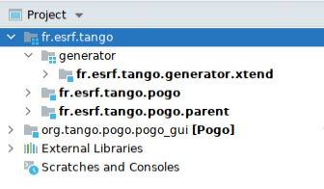
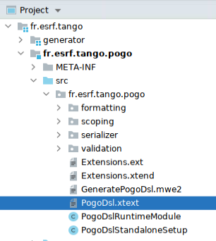
Pogo TANGO code generator
Pogo project packages:
Defining the class model

Slide 6
Pogo TANGO code generator
PogoDeviceClass:
"deviceclass" name=ID (isAbstract?="abstract")? ("extends" baseClass=[PogoDeviceClass])?
"{"
pogoRevision = ID // To check Pogo revision when xmi has been created
institute = ID // For future specific features
"description:" // Class information
(description=ClassDescription)
"classProperties:" // Class property list
(classProperties+=Property)*
"deviceProperties:" // Device Property list
(deviceProperties+=Property)*
"commands:" // Device static command list
(commands+=Command)*
"dynamicCommands:" // Device dynamic command list
(dynamicCommands+=Command)*
"attributes:" // Device static attribute list
(attributes+=Attribute)*
"dynamicAttributes:" // Device dynamic attribute list
(dynamicAttributes+=Attribute)*
"forwardedAttributes:" // Device forwarded attribute list
(forwardedAttributes+=ForwardedAttribute)*
"pipes:" // Device pipe list
(pipes+=Pipe)*
"states:" // Device state list
(states+=State)*
preferences = Preferences // Preferences (for programmer, for site or at run time)
"additionalFiles:" // Programmer's additional files to be added in Makefile (utilities, threads,...)
(additionalFiles+=AdditionalFile)*
"overlodedPollPeriodObject:" // Object list (Command or Attribute) where polling period has been overloaded
(overlodedPollPeriodObject += OverlodedPollPeriodObject)*
"}";

Slide 7
Pogo TANGO code generator
PogoDeviceClass:
"deviceclass" name=ID (isAbstract?="abstract")? ("extends" baseClass=[PogoDeviceClass])?
"{"
pogoRevision = ID // To check Pogo revision when xmi has been created
institute = ID // For future specific features
"description:" // Class information
(description=ClassDescription)
"classProperties:" // Class property list
(classProperties+=Property)*
"deviceProperties:" // Device Property list
(deviceProperties+=Property)*
"commands:" // Device static command list
(commands+=Command)*
"dynamicCommands:" // Device dynamic command list
(dynamicCommands+=Command)*
"attributes:" // Device static attribute list
(attributes+=Attribute)*
"dynamicAttributes:" // Device dynamic attribute list
(dynamicAttributes+=Attribute)*
"forwardedAttributes:" // Device forwarded attribute list
(forwardedAttributes+=ForwardedAttribute)*
"pipes:" // Device pipe list
(pipes+=Pipe)*
"states:" // Device state list
(states+=State)*
preferences = Preferences // Preferences (for programmer, for site or at run time)
"additionalFiles:" // Programmer's additional files to be added in Makefile (utilities, threads,...)
(additionalFiles+=AdditionalFile)*
"overlodedPollPeriodObject:" // Object list (Command or Attribute) where polling period has been overloaded
(overlodedPollPeriodObject += OverlodedPollPeriodObject)*
"}";

Slide 8
Pogo TANGO code generator
//
// Command Definition
//
Command:
name = ID
argin = Argument
argout = Argument
description = STRING
status = InheritanceStatus
execMethod = STRING
displayLevel = DisplayLevel
polledPeriod = STRING
isDynamic = Boolean
"excludedStates:"
(excludedStates+=STRING)*
;
Argument: type=Type description=STRING;
DisplayLevel: "OPERATOR" | "EXPERT";
InheritanceStatus:
abstract = Boolean // is abstract or inherited from abstract
inherited = Boolean // is inherited
concrete = Boolean // is concrete or overloaded
concreteHere = Boolean // is concrete or overloaded in this class
hasChanged = STRING; // What has changed (dataType, attType, RWtype)

Slide 9
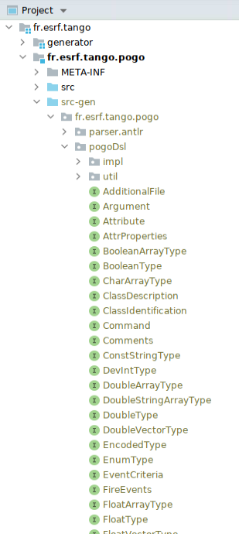
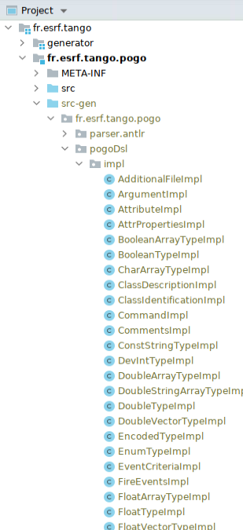
Pogo TANGO code generator
Compiling fr.esrf.tango.pogo/src/PogoDsl.xtext generates 2 packages:
  Java Interfaces and Java classes Implementation

Slide 10
Pogo TANGO code generator
  Workflow Principle:
Xtext/Xtend environment
Tango Code Generator
Tango Concept
Device Class Programmer
Using
Graphic User Interface
TANGO designer
Defining TANGO
model grammar
with Xtext
Code templates with
Xtend for
C++, java and python
JAVA GUI
displaying model
As a tree
Xmi file defining
Concrete model
Java API to
access model
Export as jar file
Jar file with
API, EMF, oAW classes
and templates
Source code files
C++, java, python

Slide 11
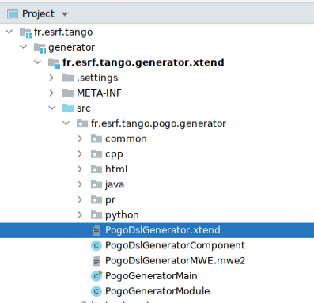
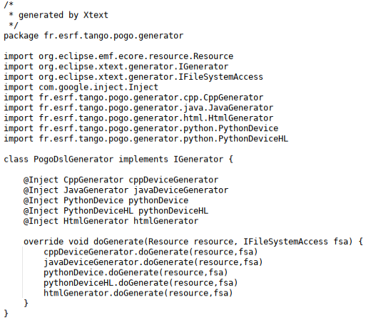
Pogo TANGO code generator
Now you can use these packages to implement code using Xtend.

Slide 12
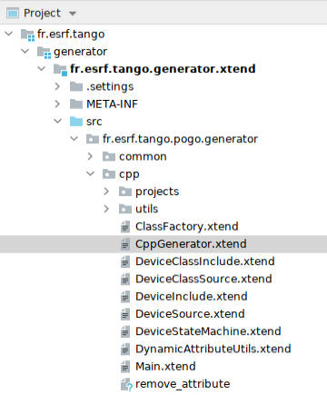
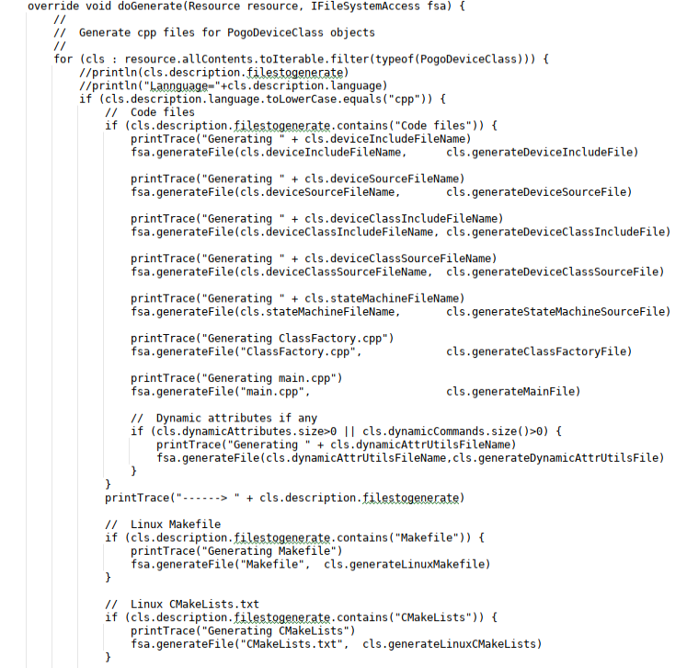
Pogo TANGO code generator
Now you can use these packages to implement code using Xtend.

Slide 13
Pogo TANGO code generator
Xtend syntax:
  Method definition:
def generateDeviceSourceFile (PogoDeviceClass cls) ''‘
- - - -
''‘
  Everything in this method will be in code generation, except code inside « »
    Xtend call:
    «IF » «ENDIF», «FOR » «ENDFOR», ….
    Model data members call:
    #include <«cls.name».h>
    Xtend or java method call:
      «[param1].[method name]([param2, param3,…])»
    «cls.protectedArea("init_device", "Initialize device", true)»
/**
* «cls.name» class description:
* «cls.description.description.comments("* ")»
*/

Slide 14
Pogo TANGO code generator
def generateDeviceSourceFile (PogoDeviceClass cls) '''
«cls.fileHeader»
/**
* «cls.name» class description:
* «cls.description.description.comments("* ")»
*/
«cls.commands.commandsTable»
«cls.attributes.attributesTable»
namespace «cls.name»_ns
{
«cls.protectedArea("namespace_starting", "static initializations", true)»
«cls.constructors»
«cls.initDeviceMethod»
«cls.utilsMethods»
«cls.attributeMethods»
«cls.pipeMethods»
«cls.commandMethods»
«cls.protectedArea("namespace_ending", "Additional Methods", true)»
} // namespace
'''

Slide 15
Pogo TANGO code generator
Methods can be written in Xtend
def fileHeader (PogoDeviceClass cls) '''
«cls.protectedArea(".cpp",
cls.deviceSourceFileHeader+
"\n\n" +
"#include <"+cls.name+".h>\n"+
"#include <"+cls.name+"Class.h>", false)»
''‘
Ot in java
public String protectedArea(PogoDeviceClass cls, String method, String code, boolean comments) {
if (comments)
return openProtectedArea(cls, method)+ "\n" +
"// " + CppStringUtils.comments(code, " // ") + "\n\n" +
closeProtectedArea(cls, method);
else
return openProtectedArea(cls, method) +
code + "\n\n" +
closeProtectedArea(cls, method);
}

Slide 16
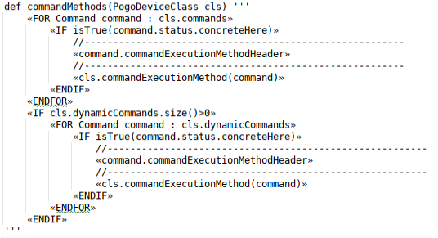
Pogo TANGO code generator
Methods written in Xtend
Xtend uses special cotes: « Xtend code »
Under Eclipse these cotes are [Ctrl + Shift + ‘<‘ or ‘>’]
It seems not possible with Intelli JIdea except with copy/paste

Slide 17
Pogo TANGO code generator
  Workflow Principle:
Xtext/Xtend environment
Tango Code Generator
Tango Concept
Device Class Programmer
Using
Graphic User Interface
TANGO designer
Defining TANGO
model grammar
with Xtext
Code templates with
Xtend for
C++, java and python
JAVA GUI
displaying model
As a tree
Xmi file defining
Concrete model
Java API to
access model
Export as jar file
Jar file with
API, EMF, oAW classes
and templates
Source code files
C++, java, python

Slide 18
Pogo TANGO code generator
Java GUI:
The java GUI, loads a xmi file as a PogoDeviceClass object (OAWutils.java) as defined in
PogoDsl.xtext file
PogoDeviceClass:
"deviceclass" name=ID (isAbstract?="abstract")? ("extends" baseClass=[PogoDeviceClass])?
"{"
pogoRevision = ID // To check Pogo revision when xmi has been created
institute = ID // For future specific features
"description:" // Class information
(description=ClassDescription)
"classProperties:" // Class property list
(classProperties+=Property)*
- - - - - - -
And convert it in a DeviceClass object to be used during design.
When Generate option is clicked, a new DeviceClass object is build from the tree, converted in PogoDeviceClass
object passed to OAWutils.java file to be saved in a xmi file (and generate code if requested).
For compatibility reasons, few methods modify the xmi file content just before load.
And just before code generation

Slide 19
Pogo TANGO code generator
Remarks about Protected Regions(PR):
The PRs are fully managed the lib package.
Each PR needs to have a unique name. It is build using class name, method name and/or usage.
i.e.
/*----- PROTECTED REGION ID(Starter::reset_statistics) ENABLED START -----*/
Bla bla bla….
/*----- PROTECTED REGION END -----*/ // Starter::reset_statistics
But: if a command name has changed, the execution method name will change too.
Consequently, the PR name change too.
Xtend cannot recognise it and the protected code is lost.
To avoid it, when an object name change, the old and new names are added in a list to get code from old PR
before code generation and reinjected in PR with new name after.

Slide 20
Thank you!
Questions?

