Slide 1

1st Tango Kernel Webinar
cppTango Overview
Reynald Bourtembourg - ESRF
Thomas Braun - ( ) byte physics
Michal Liszcz - S2INNOVATION
https://www.tango-controls.org

Slide 2
Outline
1. Introduction (Reynald)
2. cppTango repository overview (Reynald)
3. cppTango dependencies (Reynald)
4. How to compile cppTango? (Thomas)
5. How to run the tests? (Thomas)
6. How to add a new test? (Thomas)
7. Architecture overview (Michal)
8. Practical example: Code navigation. What happens when an attribute is read? (Michal)
9. Questions (You)

Slide 3

Introduction
Goals:
Share knowledge on Tango Kernel
… before the Tango Creators retire or get affected by Alzheimer or MIB
Encourage contributions to Tango Kernel
~ 1 webinar per month
Questions/Answers session at the end
http://gph.is/28RgAAs

Slide 4
cppTango Repository Overview
https://github.com/tango-controls/cppTango

Slide 5
Development branches
tango-9-lts | 9.3-backports
Future cppTango 9.4 | (9.3.x development branch)
Requires C++14 at least | Does not require C++11 (Can be compiled on old compilers but might need a more recent CMake version)
Not binary compatible with cppTango 9.3.x | Binary compatible with cppTango 9.3.x
Travis CI: Latest LLVM (11.0) Latest GCC (10.2.0) Ubuntu 20.04 Debian 8, 9 , and 10 | Travis CI: Debian 7, 8, 9 , and 10
Appveyor: win32 msvc14 and msvc 15 x64 msvc14 and msvc15 | Appveyor: win32 msvc9, msvc10, msvc12, msvc14 and msvc 15 x64 msvc9, msvc10, msvc12, msvc14 and msvc 15
Original slide by Michal Liszcz

Slide 6
Tango 9 LTS
Future cppTango 9.4 release
  Breaks ABI (i.e. not binary compatible with 9.3)
Developed on tango-9-lts branch
  Since Mar 29, 2019 (9.3-backports branchout)
Improvements in all areas
  Bugfixes and features
  Software quality and safety
  Tooling and CI infrastructure
Original slide by Michal Liszcz

Slide 7

Tango 9 LTS - Bugfixes
Solutions may differ from 9.3.x ones
  No ABI restrictions
  We can follow the “boy scout rule” and refactor
Some bugs are resolved on 9.3-backports first and wait for forward port
http://gph.is/1JIu1fj
From an original slide by Michal Liszcz

Slide 8


Contribution Rules
Advices in Contributing.md:
Discuss addition and changes first => Github issue
http://gph.is/2bVPjt4
http://gph.is/2vIv8f0

Slide 9
Contribution Steps
Fork the repository to your own user
Add your fork as new remote:
git remote add myFork git@github.com:<user>/cppTango.git
Create a new branch for your work
Start hacking
Create a pull request with your changes
Your fixes should always be based on the default branch tango-9-lts.
Only after accepting a PR against that branch, we can start integrating a fix for the current stable version in the 9.3-backports branch.
Notes:
If you have a fix which is specific to 9.3-backport and if you do a PR to that branch, we will have a look at it of course.

Slide 10
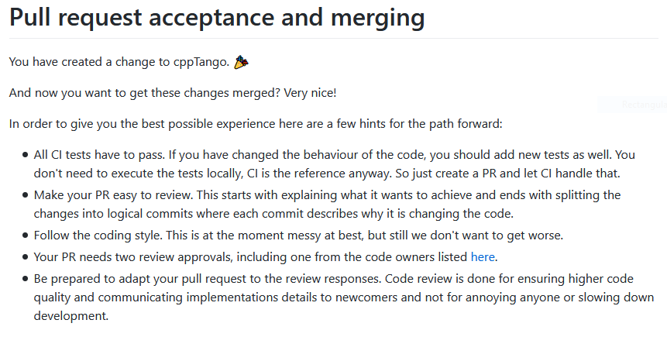
Contribution Rules
Extract from Contributing.md:

Slide 11
cppTango Dependencies
omniORB >= 4.2.2 (C++ CORBA)
libzmq >= 4.0.5 (events)
cppzmq (zeromq C++ wrapper)
tango-idl (Tango CORBA Interface)
cmake >= 3.7
C++14 compliant compiler (GCC, Clang, Visual Studio >=2015)
Notes:
The ZeroMQ project cppzmq provides C++ bindings for libzmq.
With them we can exercise the power of ZeroMQ with idiomatic, modern C++.
The bindings provide type safety, exception-based error reporting, the RAII (Resource Acquisition is Initialization idiom) approach to resource management.

Slide 12
cppTango Dependencies: omniORB
CORBA = Common ORB Architecture

Slide 13
cppTango Dependencies: omniORB
CORBA = Common ORB Architecture
Technical Standard

Slide 14
cppTango Dependencies: omniORB
CORBA = Common ORB Architecture
Technical Standard
CORBA = technical standard for something called ORB

Slide 15
cppTango Dependencies: omniORB
ORB = Object Request Broker
ORB = Object-oriented version of RPC (Remote Procedure Call)
ORB = Mechanism for invoking operations on an object (calling a Procedure) in a different (Remote) process that may be running on the same or different computer.
At programming level, remote calls look similar to local calls
Notes:
Many people refer to CORBA as middleware or integration software. This is because CORBA is often used to get existing, stand-alone applications communicating with each other. A tag-line used by IONA Technologies, Making Software Work Together™, sums up the purpose of CORBA.

Slide 16
cppTango Dependencies: IDL
IDL = Interface Definition Language
An IDL file defines the public API that is exposed by objects in a server application
When using Tango, there is only 1 IDL file
(usually hidden to the device server and client programmer):
https://github.com/tango-controls/tango-idl/blob/tango-9-lts/tango.idl
IDL = API defined in a way which is independent of any particular programming language

Slide 17
cppTango Dependencies: IDL
omniORB IDL Compiler = omniidl
CORBA standard defined mapping from IDL to programming languages
tango.idl
omniidl
IDL Compiler
idl2j, jgen
C++
Java
Other programming Language
Stub code
Skeleton code
Stub code
Skeleton code
Stub code
Skeleton code

Slide 18


cppTango Dependencies:IDL
Stub/Proxy code
Remote calls = local call upon a stub procedure/object
Stub uses inter-process communication mechanism (TCP/IP sockets, …) to transmit the request to a server process and receive back the reply
Term proxy often used instead of stub
CORBA proxy = a client-side object that acts on behalf of the “real” object in a server process
Photo by Rae Tian on Unsplash
Image by marlene_charlotte from Pixabay
Notes:
The word stub has several meanings. A dictionary definition of stub is “the short end remaining after something bigger has been used up, for example, a pencil stub or a cigarette stub”. In traditional (non-distributed) programming, a stub procedure is a dummy implementation of a procedure that is used to prevent “undefined label” errors at link time. In a distributed middleware system like CORBA, remote calls are implemented by the client making a local call upon a stub procedure/object.
The stub uses an inter-process communication mechanism (such as TCP/IP sockets) to transmit the request to a server process and receive back the reply.
The term proxy is often used instead of stub. A dictionary definition of proxy is “a person authorized to act for another”. For example, if you would like to vote on an issue but are unable to attend the meeting where the vote will take place then you might instruct somebody else to vote on your behalf. If you do this then you are “voting by proxy”. The term proxy is very appropriate in CORBA (and other object-oriented middleware systems). A CORBA proxy is simply a client-side object that acts on behalf of the “real” object in a server process. When the client application invokes an operation on a proxy, the proxy uses an inter-process communication mechanism to transmit the request to the “real” object in a server process; then the proxy waits to receive the reply and passes back this reply to the application-level code in the client.

Slide 19

cppTango Dependencies:IDL
Skeleton code
Skeleton code = server-side code for:
  reading incoming requests
  dispatching requests to application-level objects
http://gph.is/18HQbaL
Notes:
The term skeleton code refers to the server-side code for reading incoming requests and dispatching them to application-level objects. The term skeleton may seem like a strange choice. However, use of the word skeleton is not limited to discussions about bones; more generally, it means a “supporting infrastructure”. Skeleton code is so called because it provides supporting infrastructure that is required to implement server applications.

Slide 20

cppTango Dependencies:IDL
Skeleton code
Skeleton code = server-side code for:
  reading incoming requests
  dispatching requests to application-level objects
Skeleton code ⬄ Supporting Infrastructure required to implement server applications
http://gph.is/2cZTNnv
Notes:
The term skeleton code refers to the server-side code for reading incoming requests and dispatching them to application-level objects. The term skeleton may seem like a strange choice. However, use of the word skeleton is not limited to discussions about bones; more generally, it means a “supporting infrastructure”. Skeleton code is so called because it provides supporting infrastructure that is required to implement server applications.

Slide 21
cppTango Dependencies: IDL
omniORB IDL Compiler = omniidl (requires python)
tango.idl
omniidl
IDL Compiler
idl2j, jgen
C++
Java
Other programming Language
Stub code
Skeleton code
Stub code
Skeleton code
Stub code
Skeleton code

Slide 22
cppTango Dependencies: CORBA
CORBA explained simply:
http://www.ciaranmchale.com/corba-explained-simply

Slide 23

How to compile cppTango?
Thomas Braun – ( ) byte physics
Photo by Rohit Farmer on Unsplash

Slide 24
Thank you!
Any questions?
https://www.github.com/tango-controls/cppTango/issues

