Slide 1

Overview of TANGO
Control system
http://www.tango-controls.org/
EUROPEAN SYNCHROTRON RADIATION FACILITY

Slide 2
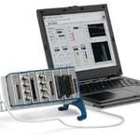
A simple acquisition system
For simple system
Many tools exists
  Labview
  Scadas
  Etc…
Bigger systems need several computers

Slide 3
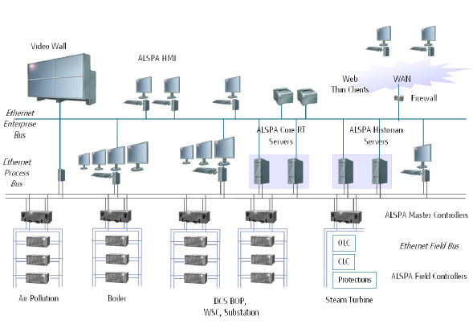
A distributed system
Need inter-computer communication
Heterogenic system (languages, machines…)
Serialization/de-serialization
Variable addressing, topology,

Slide 4
Object oriented
Analyze a system as a set of objects communicating together
Each object is in charge of its own life
An object can be built on other objects

Slide 5

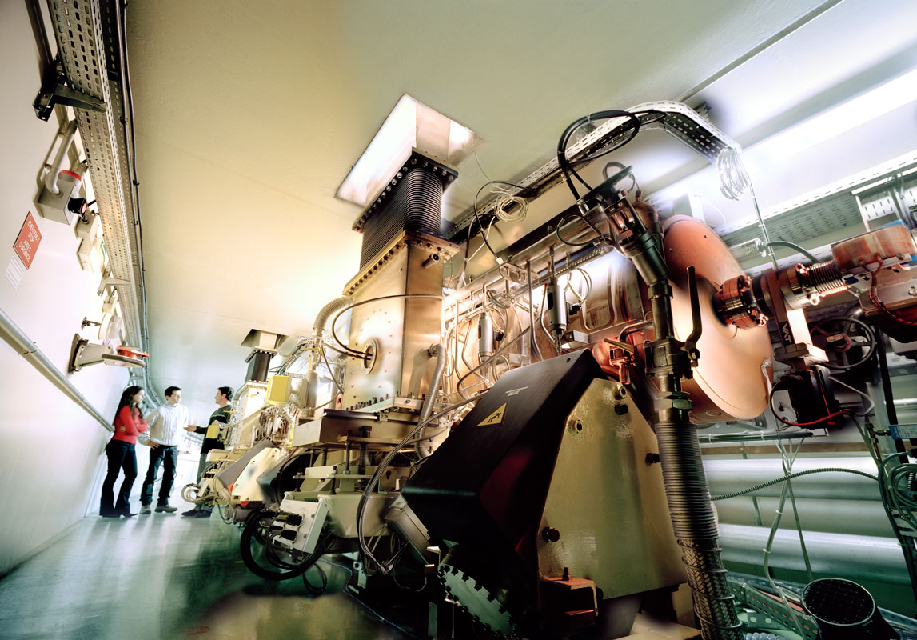
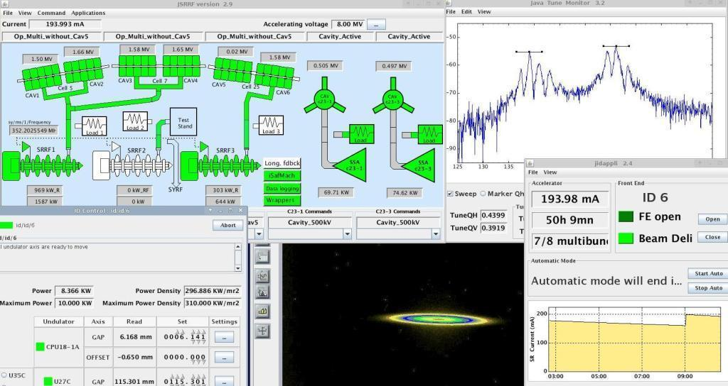
A European Control System framework
«Remote control anything and everything»
A mature Open Source product
> 100 man years of development
Used in 15+ big instruments
Active community
Object oriented, topology independent, highly scalable,
Operating system independent
Multi language

Slide 6

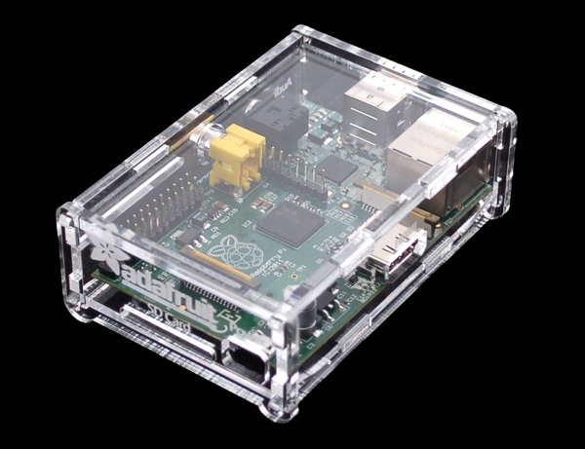
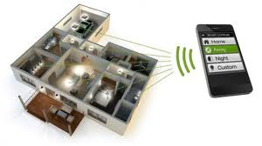
is HIGHLY scalable !
From small embedded platforms

Slide 7
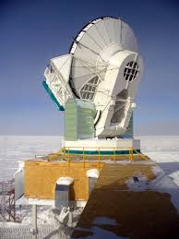
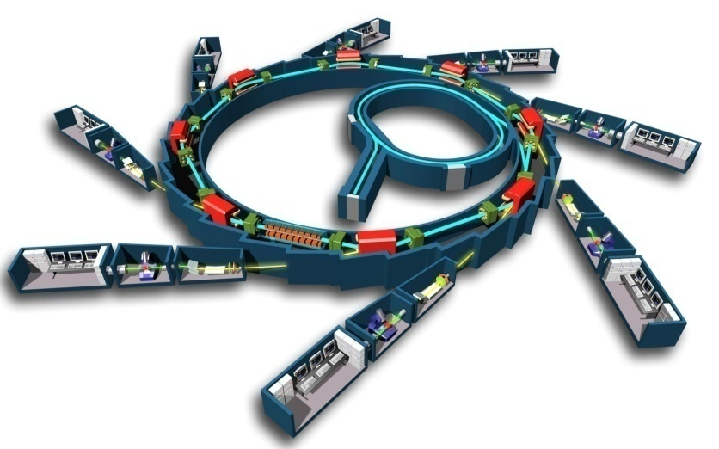
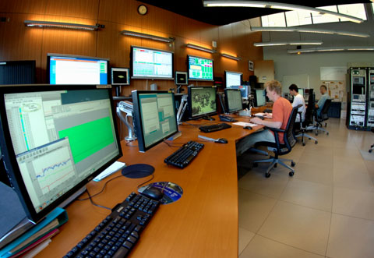
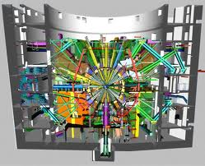

… to big scientific instruments
> 1 000 000 signals and actuators

Slide 8
A software bus
development
tools
Generic Services
User environment
Matlab,Labview Igor, Python
Data
Analysis
Application Tool-Kit
Config
Monitor
Sequencing
Archiving
API Library
TANGO Software Bus distributed on a network
Interface
Generator
Device
Device
Device
Device
Device
Hardware
Hardware
Hardware
Hardware
Hardware
Catalog of
device servers

Slide 9
Topology independent
An element is identified on the overall network
The computer is just a container
The system is seen globally
A database is used to localize the objects

Slide 10
The fundamental brick of TANGO is the Device
TANGO software Bus
The device is a remote object
Interface
Device class
Standard interface for hardware equipment or service
HW
(motor…)
Notes:
Tango est un bus logiciel, et on vient clipser des éléments dessus. L’élément de base s’appelle un Device Server
Un DS: c’est un server logiciel qui gère un équipement HW. c’est le representant logiciel du HW

Slide 11
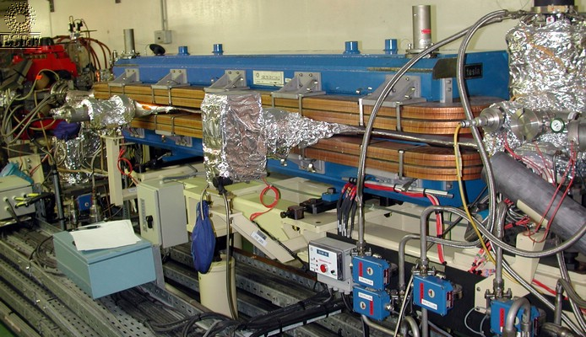
Some device(s)
One device
One device
One device

Slide 12
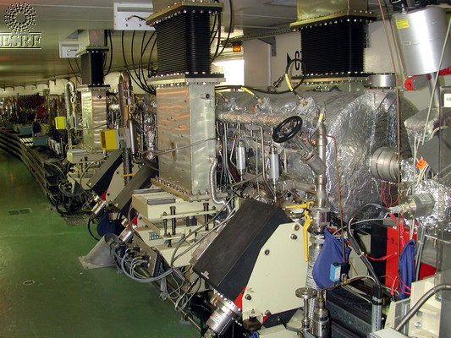
A sophisticated device (RF cavity)
another
device

Slide 13
TANGO devices
Example: motor interface:
MOTOR:
Commands: On(), Off(), …
Attributes: Speed, Position
State: On, Off, Alarm, Fault
Interface
Automatic
code generator
Hardware control code
To be written
By the programer
Notes:
L’interface c’est la partie « visible » du device server
Attributs: principalement une grandeur quantifiable
Commande: non quantifiable

Slide 14
TANGO devices
1 Device can also interface complex systems
  Hierarchical structure
Client
Client
TANGO Software Bus
Macro device: e.g. Accelerator
sub devices: e.g. powersupplies
sub devices: e.g. ADC, modbus…

Slide 15

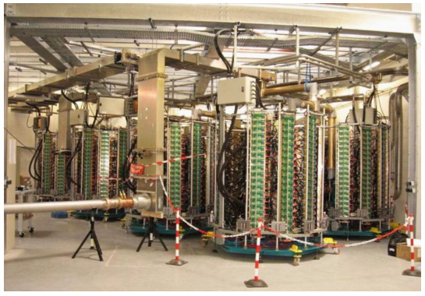
Managing complexity simply
Hierarchical structures ideal
for managing complex systems
GUI
Sequencer
High Level
SSA
Python Sequences
4x
SSA
Low Level RF
Driver
Dummy Load
280V PS
ADC
Measurements
Interlocks
fast
Interlocks
slow
Wave Guide
Switches

Slide 16


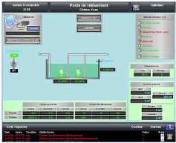
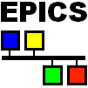




TANGO as a bridge
TANGO
JAVA/C++/Python
clients
Industrial SCADA
Tango
binding
Tango
binding
Tango binding
Object oriented layer above EPICS…
TANGO Software Bus
Device
Server
Device
Server
Device
Server
Device
Server
Device
Server
server
Hardware
electronic
Modbus
server
Data socket
server
PLC network
PLC or
embedded
system
acquisition
system
Build a TANGO object from a set of channels

Slide 17
Commands & Attributes
On the network a Tango device mainly has
  Command(s): Used to implement “action” on a device (switching ON a power supply)
  Attribute(s): Used for physical values (a motor position, a temperature, a spectrum, an matrix)
Clients ask Tango devices to execute a command or read/write one of its attributes
A Tango device also has a state and a status which are available using command(s) or as attribute(s)

Slide 18
Commands
A command may have one input and one output argument.
A limited set of argument data types are supported
  Boolean, short, long, long64, float, double, string, unsigned short, unsigned long, unsigned long64, array of these, 2 exotic types and State data type

Slide 19
Attributes
Self describing data via a configuration
Thirteen data types supported:
  Boolean, unsigned char, short, unsigned short, long, long64, unsigned long, unsigned long64, float, double, string, state and DevEncoded data type
Three accessibility types
  Read, write, read-write
Three data formats
  Scalar (one value), spectrum (an array of one dimension), image (an array of 2 dimensions)

Slide 20
Attributes
When you read an attribute you receive:
  The attribute data (luckily…)
  An attribute quality factor
    ATTR_VALID, ATTR_INVALID, ATTR_CHANGING, ATTR_ALARM, ATTR_WARNING
  The date when the attribute was acquired by the server (number of seconds and usec since EPOCH)
  Its name
  Its dimension, data type and data format
When you write an attribute, you send
  The attribute name
  The new attribute data

Slide 21
TANGO devices
1 Device can also interface complex systems
  Bridge to other protocols
TANGO Software Bus
Interface
Build TANGO device from a set of OPC TAGs
Infrastructure
server
Device
Air Conditioning
OPC

Slide 22
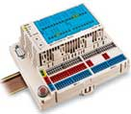
TANGO devices
1 Device can also interface complex systems
  Bridge to other protocols
TANGO Software Bus
Interface
Embedded
system
Device
I/O
Modbus TCP/IP

Slide 23
TANGO devices
1 Device can also interface complex systems
  Bridge to other protocols
TANGO Software Bus
Interface
Device
I/O
Build a TANGO device from DataSocket urls
DataSocket

Slide 24
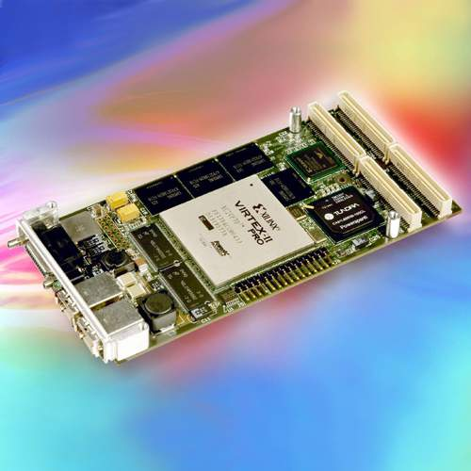
Embedded TANGO servers
Next steps
TANGO
client
TANGO Software Bus
TANGO server
Mapped into a
FPGA

Slide 25
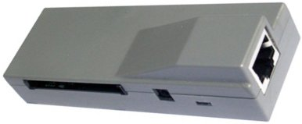
Embedded TANGO servers
Next steps
TANGO
client
TANGO Software Bus
Gumstix SBC

Slide 26
The Tango Device Server
A Tango device server is the process where the Tango class(es) are running.
A Tango device server
Tango device class A
Tango device class B
Device
sr/v-ip/1
Device
sr/v-ip/2
Device
id4/mot/1
Device
id4/mot/1
Device
id4/mot/3
“ps” command shows one device server

Slide 27
TANGO Communication
Synchronous
Client
Send
request
Wait
Get Answer
TANGO Software Bus
Do the job
server

Slide 28
TANGO Communication
Asynchronous
Client
Send
request
Do other
job
Get Answer
When needed
TANGO Software Bus
Do the job
server

Slide 29
TANGO Communication
Event Driven
Client
Subscribe
once
Callback
Do other
job
TANGO Software Bus
Do its job
Signal event
When occurs
(state change)
server

Slide 30
Abstract interface classes
Standardise interfaces of equipment of the same types
TANGO software Bus
Abstract
motor
Abstract
powersupply
Interface
Interface
Concrete
Concrete
Concrete
Concrete
Concrete
Concrete
Implem
Concrete
Concrete
Implem
Implem
Implem
Implem
Implem
Implem
Implem
Different types
of motors
Different types
of powersupplies
Notes:
Tango est un bus logiciel, et on vient clipser des éléments dessus. L’élément de base s’appelle un Device Server
Un DS: c’est un server logiciel qui gère un équipement HW. c’est le representant logiciel du HW

Slide 31

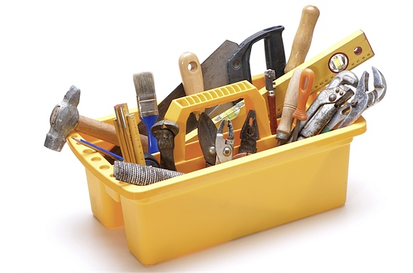
Much more than a software bus
Code generator for C++, Java, python
Configuration tool
Administration tool
Archiving service
Access control service
Logging service
Scan service
GUI Toolkit for Java,QT, Python
Synopsis animation tool
Alarm service
Web interface
Android support
Tutorials
Bindings
Many utility classes
Hardware access class catalog
Mailing list support

Slide 32
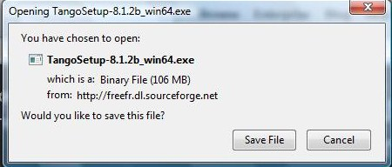


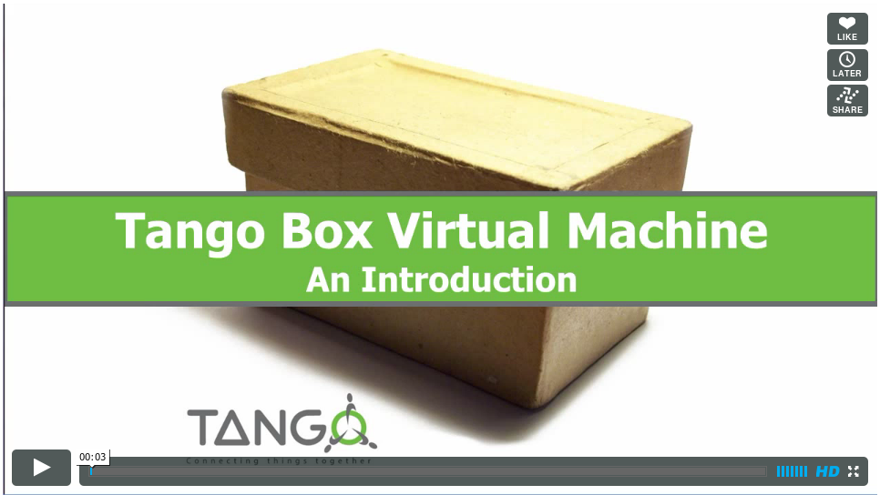
How to try it?
TANGO is available free of charge
Source code distribution
Downloadable on http://www.tango-controls.org/download
Binary Packages
  Available for Ubuntu + Debian Linux in the standard distributions
  sudo apt-get install tango-common tango-db python-pytango
  Available for Windows on http://www.tango-controls.org/download
The Tango Box
  An Ubuntu virtual machine with Tango
  installed and configured for easy testing
  Runs on VMware and Virtualbox

Slide 33
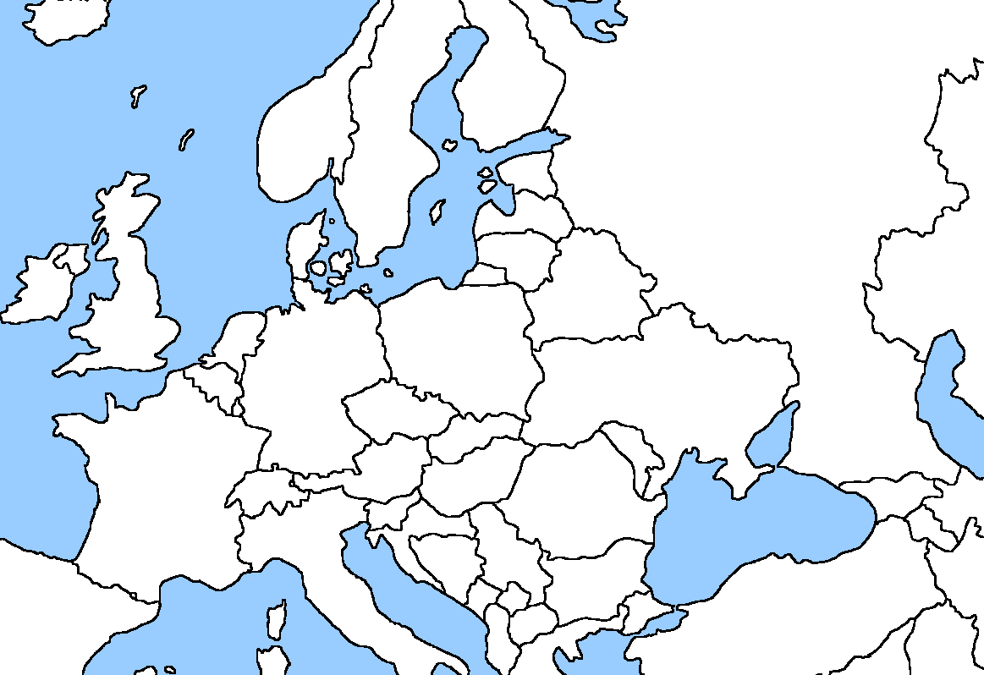








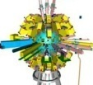



Distribution over Europe
Particle accelerators
Laser installations
Other labs
Industry service
JINR

Slide 34
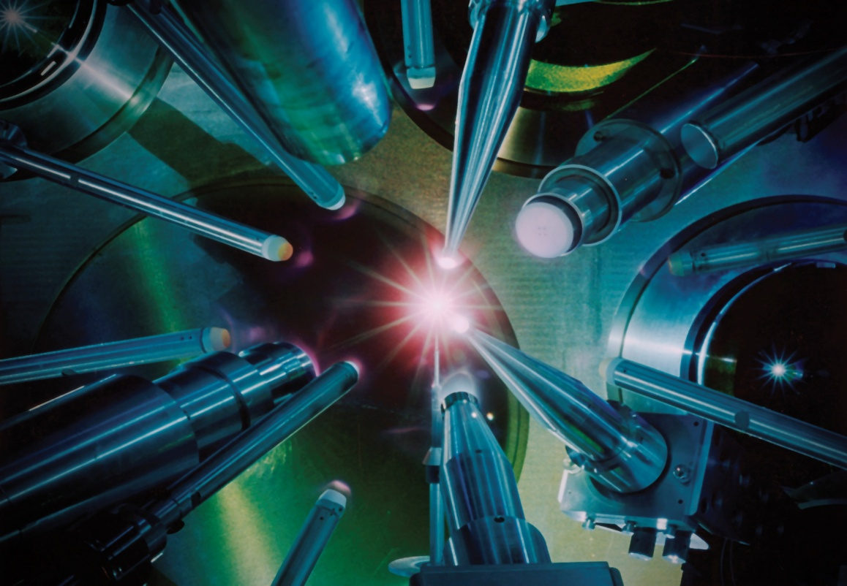
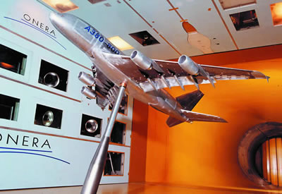
Use cases
TANGO was born in particle accelerator world, however …
TANGO is a generic solution for any collection of objects
Used also in other scientific domains like
Wind tunnels e.g. ONERA
Neutron source experiments (FRM2 + Julich in Germany)
Large laser installation
  LMJ, PETAL, APOLLON
  Free Electron Laser (Fermi)
Small instruments
  Thomx (art and medecine)
Small installations
  Embedded systems
  Industrial supervision

Slide 35
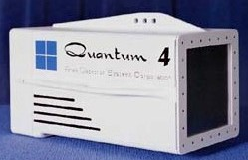

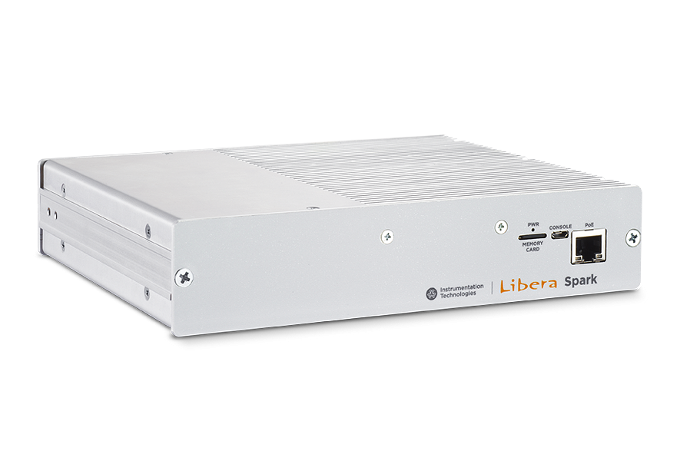
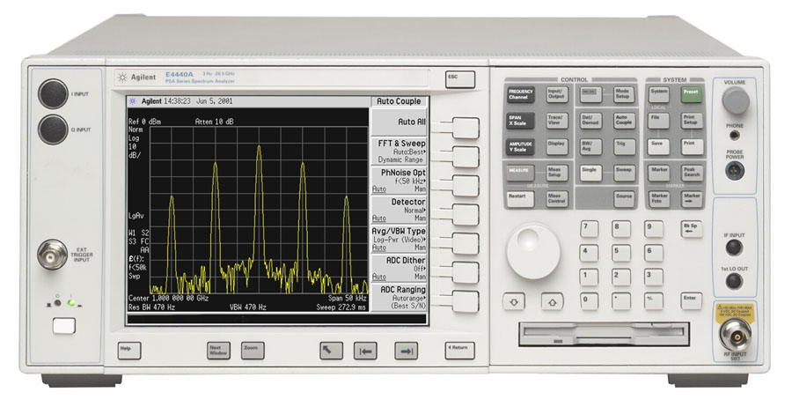

Instrumentation hardware market
TANGO – Generating economical activity
Tango compatible hardware
    Supplier provides and guaranty The TANGO interface to their product
Advantage for the supplier :
  Sales argument for addressing TANGO community
  Provide remote control of device
  Profit for free from TANGO framework
Advantage for the community/client/user
  Easier integration
  Better matching of the hardware features

Slide 36












Recent projects started with TANGO
J I N R

Slide 37
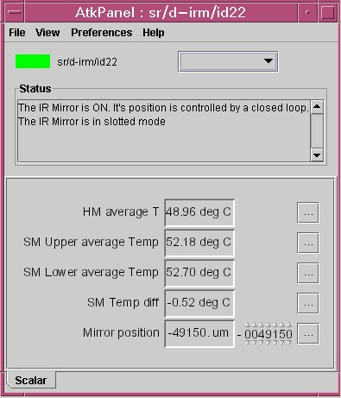
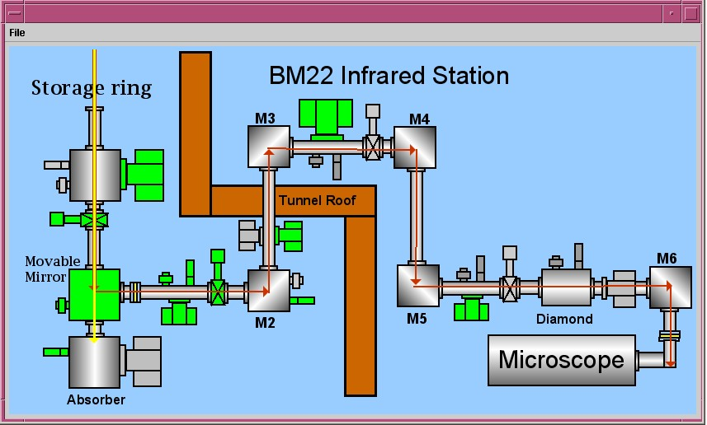
Jdraw: Generic Synoptic animation

Slide 38
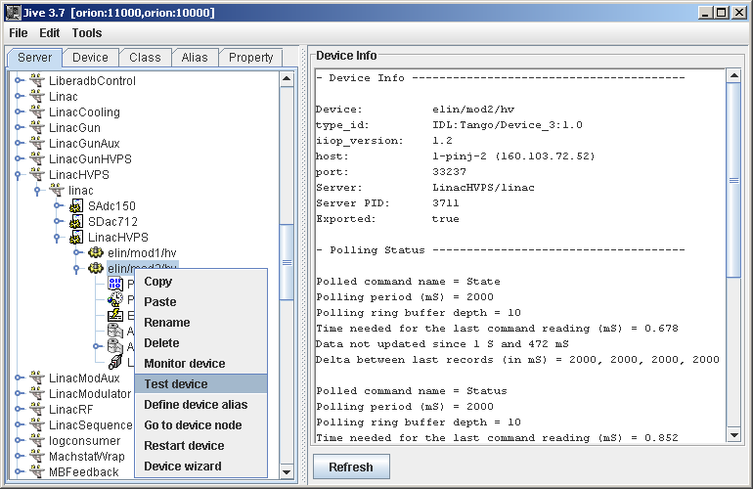
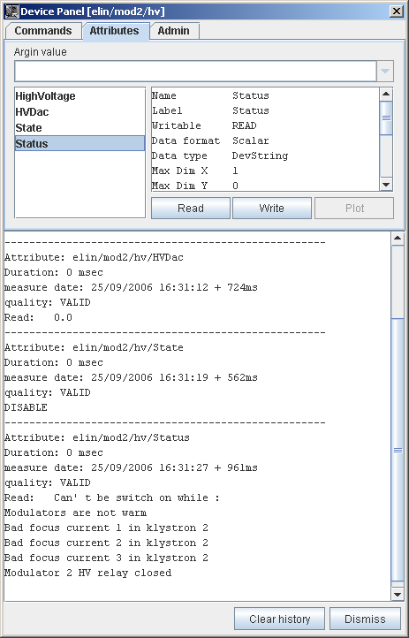
Jive
Database browser and Test Device Launcher

Slide 39
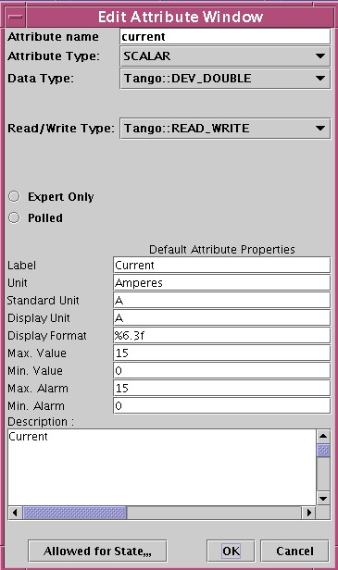
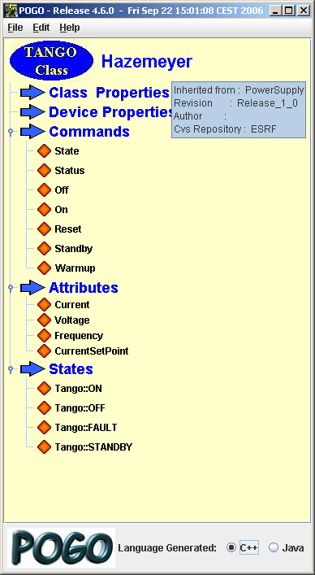
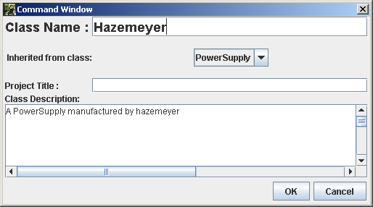
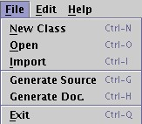
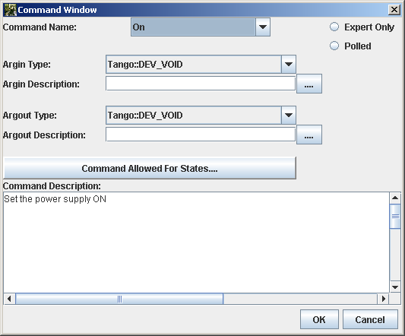
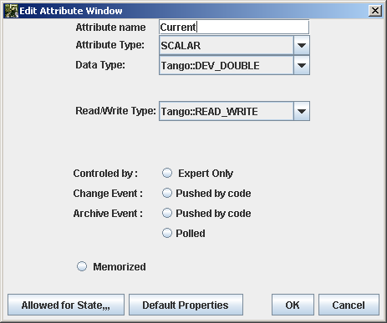
POGO Device Server Code Generator
C++ or Java

Slide 40
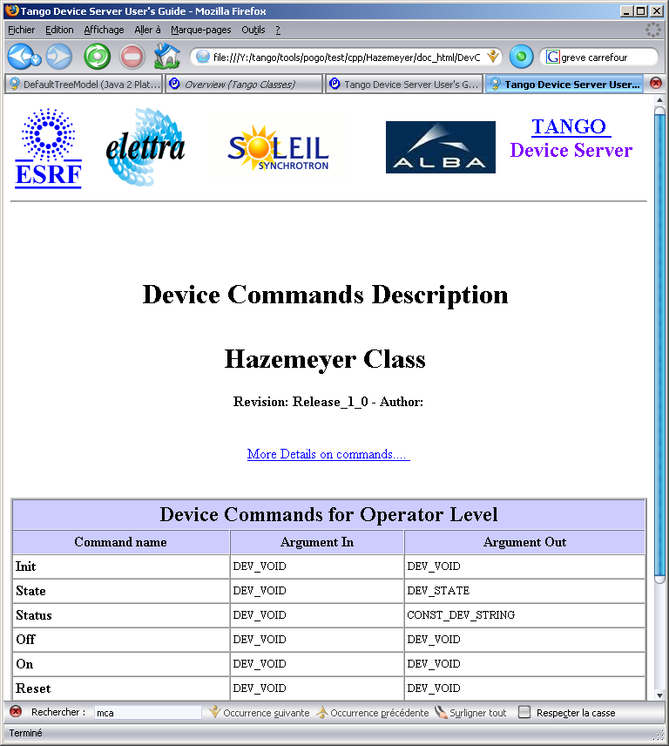
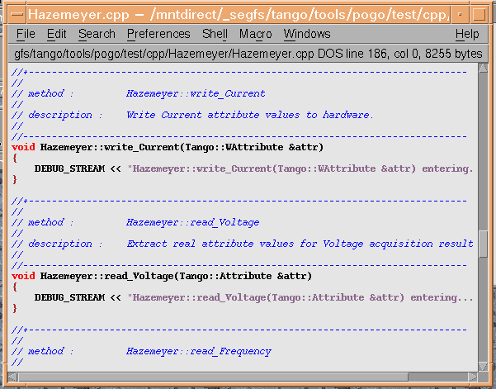
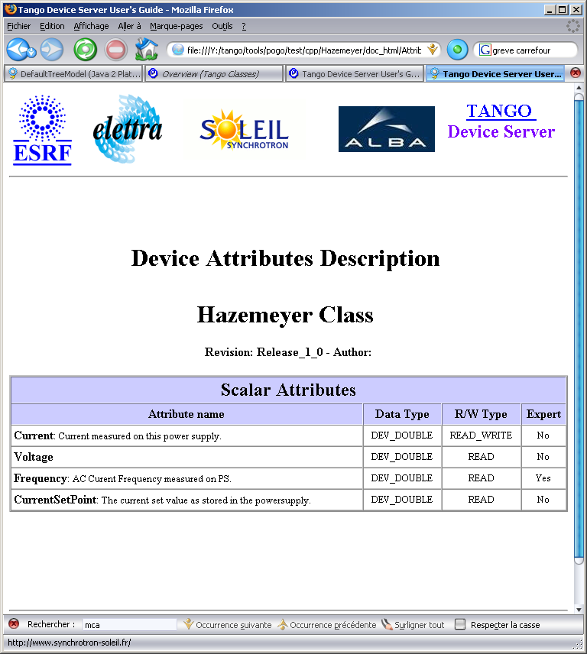
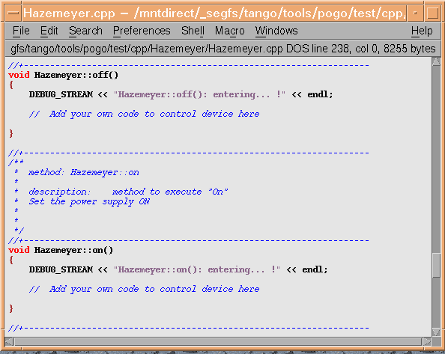
POGO Device Server Code Generator

Slide 41
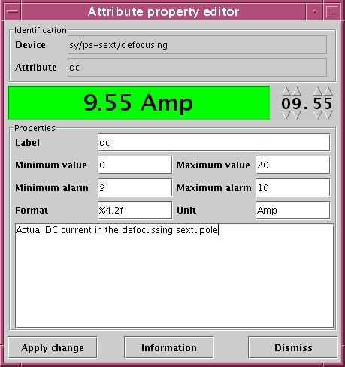
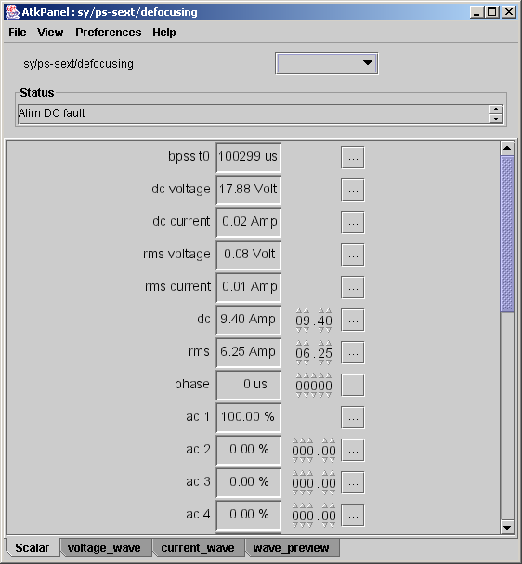
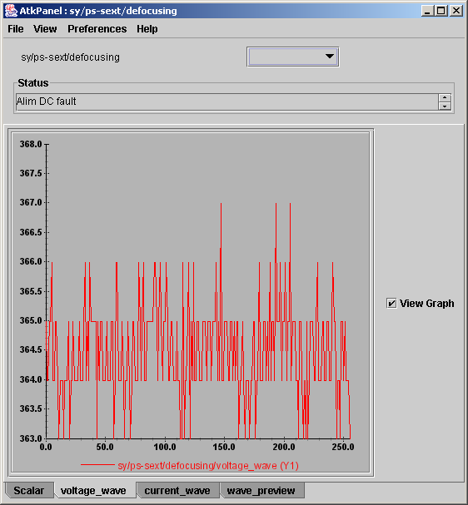
ATKpanel a generic client

Slide 42
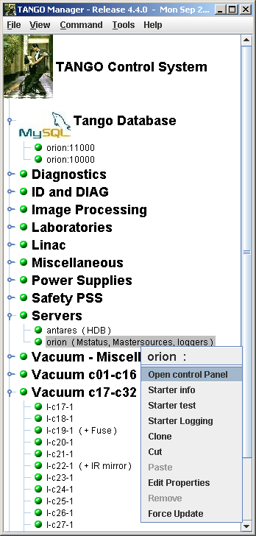
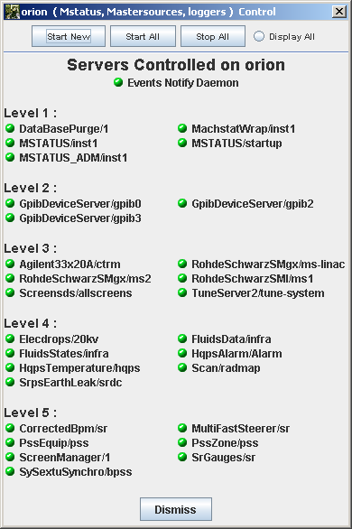
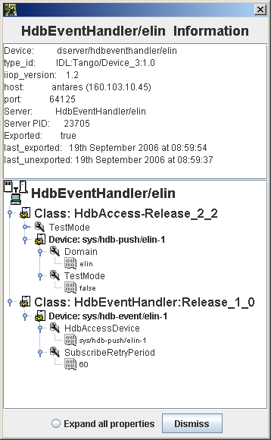
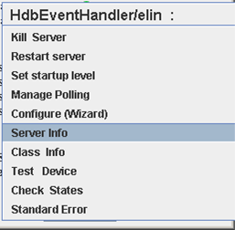
Astor/Starter
Tango Control System Manager
Get host list
DB server
Ethernet
Host n
Starter
server
Host n
Starter
server
Get status
Host n
DS
Starter
server
DS
Host n
DS
Starter
server
DS
Host n
DS
DS
Starter
server
DS
DS
DS
Host n
DS
DS
Starter
server
DS
DS
DS
Host n
DS
DS
Starter
server
DS
DS
DS
DS
DS
DS
Host 1
DS
DS
Starter
server
DS
DS
DS
DS
DS
Get server list
DS
DS
DS
DS
DS
DS
DS
DS
DS
DS
DS

Slide 43
Thank you for your attention
WWW sites for TANGO
  Common site http://tango-controls.org
http://sourceforge.net/projects/tango-cs

