Slide 1







Tango Basics

Slide 2









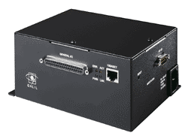
What is Tango?
A software bus for distributed objects
Java, C++,Python
TAURUS
Linux, Windows, Solaris
TANGO ATK
Java
Qtango
C++
Archiving
TANGO Software Bus
Dev
Dev
Dev
Dev
Dev
Dev
Dev
OPC
Linux, Windows, Solaris
Labview RT

Slide 3
What is Tango?
Provides a unified interface to all equipments, hiding how they are connected to a computer (serial line, USB, sockets….)
Hide the network
Location transparency
Tango is one of the Control Systems available today but other exist (EPICS, Tine, …)

Slide 4
The Tango Device
The fundamental brick of Tango is the device!
  A distributed object exposing an interface
Everything which needs to be controlled is a “device” from a very simple equipment to a very sophisticated one
Every device is known by a three field name “domain/family/member”
  sr/v-ip/c18-1, sr/v-ip/c18-2
  sr/d-ct/1
  id10/motor/10, id20/mono/2theta, id20/mirror/exp1

Slide 5
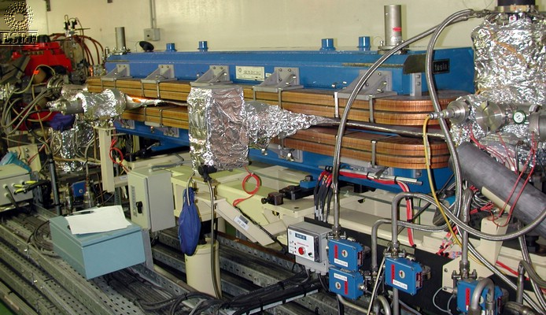
Some device(s)
One device
One device
One device

Slide 6
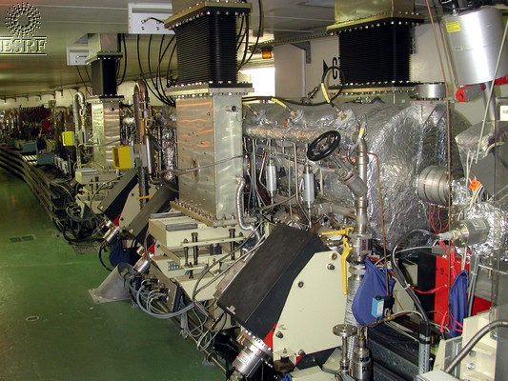
A sophisticated device (RF cavity)
another
device

Slide 7
The Tango Class
Every device belongs to a Tango class (not a computing language class)
Every device inherits from the same root class (DeviceImpl class)
A Tango class implements the necessary features to control one kind of equipment
  Example : The Agilent 4395a spectrum analyzer controlled via its GPIB interface

Slide 8
The Tango Device Server
A Tango device server is the process where the Tango class(es) are running.
A Tango device server
Tango device class A
Tango device class B
Device
sr/v-ip/1
Device
sr/v-ip/2
Device
id4/mot/1
Device
id4/mot/1
Device
id4/mot/3
“ps” command shows one device server

Slide 9
The Tango Device Server
Tango uses a database to configure a device server process
Device number and names for a Tango class are defined within the database not in the code.
Which Tango class(es) are part of a device server process is defined in the database but also in the code
  Classes have to be linked in the executable

Slide 10
The Tango Device Server
Each device server is defined by the couple “executable name / instance name”
sr/v-ip/c8-1 to sr/v-ip/c8-5
One vacuum pump
sr/v-ip/c9-1 to
sr/v-ip/c9-5
host X
sr/v-ip/c10-1 to
sr/v-ip/c10-5
VP-DS
VP-DS
Host Y
How is it possible to define that device
sr/v-ip/c9-3 belongs to the second VP-DS
running on Crate X ?
Start each device server with an INSTANCE NAME
sr/v-ip/c11-1 to
sr/v-ip/c11-5
VP-DS
VP-DS

Slide 11
The Tango Device Server
During its startup sequence, a Tango device server asks the database which devices it has to create and to manage (number and names)
Device servers are started like
  VP-DS c8
  VP-DS c10
DS exec name | Inst name | Class name | Device name
VP-DS | c8 | RibberPump | sr/v-ip/c8-1
VP-DS | c8 | RibberPump | sr/v-ip/c8-2
VP-DS | c8 | RibberPump | sr/v-ip/c8-3

Slide 12
Device server startup sequence
Clients
Db server
a/bb/1 exported
a/bb/2 exported
a/bb/1 properties
a/bb/2 properties
I am xx/yy
Give me my data
Server xy/yx
Server zz/yy
Server xx/yy
a/bb/3 exported
a/bb/4 exported
a/bb/5 exported
a/bb/6 exported
Init the hardware
hw
hw

Slide 13
Device server startup sequence
TANGO_HOST=aa:10000
Clients
a/bb/3 is from xy/yx on host hh
I need a/bb/3
Db server
Get attribute list, command list…
Direct link
a/bb/3 exported
a/bb/4 exported
a/bb/5 exported
a/bb/6 exported
a/bb/1 exported
a/bb/2 exported
Server xy/yx
Server zz/yy
Server xx/yy
hw
hw
hw
hw
hw

Slide 14
Steady state situation
Point to point links
Clients
Clients
Clients
Clients
Clients
Clients
Clients
Clients
Db server
Server
Server
Server
Server
Server
Server
Server

Slide 15
A minimum Tango System
To run a Tango control system, you need
  A running MySQL database
  The Tango database server
    It is a C++ Tango device server with one device
To start the database server on a fixed port
The environment variable TANGO_HOST is used by client/server to know
  On which host the database server is running
  On which port it is listening

Slide 16
A minimum Tango System
DataBaseds 2 –ORBendPoint giop:tcp:host:10000
TANGO_HOST=host:port (Ex : TANGO_HOST=orion:10000)
Database
server
Get device(s) IOR
Send device(s) IOR
Tango
client
CORBA requests
Device
server
Execute cmd/read-write attribute

Slide 17
Demo jive
Device servers
Devices
Classes
Admin devices

Slide 18
STARTER
Watch admin slides
Demo astor

Slide 19

Tango Basics: a device server
Commands
Attributes
States
Properties

Slide 20
TANGO devices
Example: motor interface:
MOTOR:
Commands: On(), Off(), …
Attributes: Speed, Position
State: On, Off, Alarm, Fault
Interface
Automatic
code generator
Hardware /software control code
To be written
By the programer
Notes:
L’interface c’est la partie « visible » du device server
Attributs: principalement une grandeur quantifiable
Commande: non quantifiable

Slide 21
TANGO devices
1 Device can also interface complex systems
  Hierarchical structure
Client
Client
TANGO Software Bus
Macro device: e.g. A diffracometer
An accelerator, …
sub devices: e.g. powersupplies, motors,
CCD…
sub devices: e.g. ADC, modbus…

Slide 22
Commands & Attributes
On the network a Tango device mainly has
  Command(s): Used to implement “action” on a device (switching ON a power supply)
  Attribute(s): Used for physical values (a motor position, a temperature, a spectrum, an matrix)
Clients ask Tango devices to execute a command or read/write one of its attributes
A Tango device also has a state and a status which are available using command(s) or as attribute(s)

Slide 23
Commands
A command may have one input and one output argument.
A limited set of argument data types are supported
  Boolean, short, long, long64, float, double, string, unsigned short, unsigned long, unsigned long64, array of these, 2 exotic types and State data type

Slide 24
Attributes
Self describing data via a configuration
Thirteen data types supported:
  Boolean, unsigned char, short, unsigned short, long, long64, unsigned long, unsigned long64, float, double, string, state and DevEncoded data type
Three accessibility types
  Read, write, read-write
Three data formats
  Scalar (one value), spectrum (an array of one dimension), image (an array of 2 dimensions)

Slide 25
Attributes
When you read an attribute you receive:
  The attribute data (luckily…)
  An attribute quality factor
    ATTR_VALID, ATTR_INVALID, ATTR_CHANGING, ATTR_ALARM, ATTR_WARNING
  The date when the attribute was acquired by the server (number of seconds and usec since EPOCH)
  Its name
  Its dimension, data type and data format
When you write an attribute, you send
  The attribute name
  The new attribute data

Slide 26
DEMO test device
Attributes
Attribute properties, quality factors…
Pure software devices.

Slide 27
Attribute Configuration
Attribute configuration defined by its properties
  Five type of properties
    Hard-coded
    Modifiable properties
      GUI parameters
      Max parameters
      Alarm parameters
      Event parameters
A separate network call allows clients to get attribute configuration (get_attribute_config)

Slide 28
Attribute Configuration
The hard coded attribute properties (5)
  name
  data_type
  data_format
  writable
  display level

Slide 29
Attribute Configuration
The GUI attribute properties (6)
  Description
  Label
  Unit
  Standard_unit
  Display_unit
  Format (C++ or printf)
The Maximum attribute properties (used only for writable attribute) (2)
  min_value
  max_value

Slide 30
Attribute Configuration
The alarm attribute properties (6)
  min_alarm, max_alarm
  min_warning, max_warning
  delta_t, delta_val
The event attribute properties (6)
  period (for periodic event)
  rel_change, abs_change (for change event)
  period, rel_change, abs_change (for archive event)

Slide 31
Demo atkpanel
Get attribute list
Get attribute config
Get command list
Etc…

Slide 32
States
A limited set of 14 device states is available.
  ON, OFF, CLOSE, OPEN, INSERT, EXTRACT, MOVING, STANDBY, FAULT, INIT, RUNNING, ALARM, DISABLE and UNKNOWN

Slide 33
Properties
Properties are stored in the MySQL database
No file – Use Jive to create/update/delete properties
You can define properties at
  Class level, device level and attribute level
Property data type
  Basic data types as scalar or array values

Slide 34
Demo jive
Device properties
Class properties

Slide 35
Automatically added Commands & Attributes
Three commands are automatically added
  State : In = void Out = DevState
    Return the device state and check for alarms
    Overwritable
  Status : In = void Out = DevString
    Return the device status
    Overwritable
  Init : In = void Out = void
    Re-initialise the device (delete_device + init_device)
Two attributes are automatically added
  State and Status

Slide 36
Design a device
DEMO Pogo icepap
Alarm level
Attribute properties
Expert/operator
Memorized attribute
Inheritance
…

Slide 37
Demo debug
Compile
Add in Starter
wizard
Log viewer

Slide 38

Tango Basics:
The Client API
Synchronous Calls
Error management
Asynchronous Calls
Group Calls
Events

Slide 39
Synchronous Calls
On the client side, each Tango device is an instance of a DeviceProxy class
DeviceProxy class
  Hide connection details
  Manage re-connection
The DeviceProxy instance is created from the device name
C++ : Tango::DeviceProxy dev(“id13/v-pen/12”);
Python : PyTango.DeviceProxy dev(“id13/v-pen/12”);

Slide 40
Synchronous Calls
The DeviceProxy command_inout() method sends a command to a device
The class DeviceData is used for the data sent/received to/from the command.
DeviceData DeviceProxy::command_inout (const char *, DeviceData &);
DeviceProxy.command_inout (name, cmd_param)
Tango::DeviceProxy dev(“sr/v-pen/c1”);
Tango::DeviceData d_in,d_out;
vector<long> v_in,v_out;
d_in << v_in;
d_out = dev.command_inout(“MyCommand”,d_in);
d_out >> v_out;
dev = PyTango.DeviceProxy(“sr/v-pen/c1”)
dev.command_inout(‘On’)
dev.on()
print dev.command_inout(‘EchoShort’,10)
print dev.EchoShort(10)

Slide 41
Synchronous Calls
The DeviceProxy read_attribute() method reads a device attribute (or read_attributes())
The class DeviceAttribute is used for the data received from the attribute.
DeviceAttribute DeviceProxy::read_attribute(string &);
DeviceAttribute DeviceProxy.read_attribute(name);
Tango::DeviceProxy dev(“sr/v-pen/c1”);
Tango::DeviceAttribute da;
float press;
string att_name(“Pressure”);
da = p_dev->read_attribute(att_name);
da >> press;
dev = PyTango.DeviceProxy(‘sr/v-pen/c1’)
da = dev.read_attribute(‘Pressure’)
print da.value
print dev[‘SpecAttr’].value
seq_da = dev.read_attributes([‘SpecAttr’,’Pressure’])

Slide 42
Synchronous Calls
The DeviceProxy write_attribute() method writes a device attribute (or write_attributes())
void DeviceProxy::write_attribute(DeviceAttribute &);
DeviceProxy.write_attribute(name,value)
Tango::DeviceProxy dev(“id2/motor/1);
long spe = 102;
Tango::DeviceAttribute da(“Speed”, spe);
dev.write_attribute(da);
dev = PyTango.DeviceProxy(‘et/s_lift/1)
dev.write_attribute(‘SpecAttr’,[2,3])
dev.write_attribute(‘SpecAttr’, numpy.array([6,7]))
dev[‘SpecAttr’] = [3,4]
dev.write_attributes(([‘Speed’,5],[‘SpecAttr’,[2,3]]))

Slide 43
Synchronous Calls
Many methods available in the DeviceProxy class
  ping, info, state, status, set_timeout_millis, get_timeout_millis, attribute_query, get_attribute_config, set_attribute_config…..
If you are interested only in attributes, use the AttributeProxy class

Slide 44
Error Management
All the exception thrown by the API are PyTango.DevFailed exception
One catch (except) block is enough
Ten exception classes (inheriting from DevFailed) have been created
  Allow easier error filtering
These classes do not add any new information compared to the DevFailed exception

Slide 45
Error Management
An example
try {
Tango::AttributeProxy ap(“id18/pen/2/Press”);
Tango::DeviceAttribute da;
da = ap.read();
float pre;
da >> pre;
}
catch (Tango::WrongNameSyntax &e) {
cout << “Et couillon, faut 3 / !” << endl;
}
catch (Tango::DevFailed &e) {
Tango::Except::print_exception(e);
}
try:
att = PyTango.AttributeProxy(‘d18/pen/2/Pres’)
print att.read()
except PyTango.WrongNameSyntax:
print ‘Et couillon, faut 3 / !’
except PyTango.DevFailed,e:
PyTango.Except.print_exception(e)

Slide 46
Asynchronous Calls
Asynchronous call :
  The client sends a request to a device and does not block waiting for the answer.
  The device informs the client process that the request has ended
Does not request any changes on the server side
Supported for
  command_inout
  read_attribute(s)
  write_attribute(s)

Slide 47
Group Calls
Provides a single point of control for a Group of devices
Group calls are executed asynchronously!
You create a group of device(s)
You execute a command (or R/W attribute) on the group

Slide 48
Group Calls
Using groups, you can
  Execute one command
    Without argument
    With the same input argument to all group members
    With different input arguments for group members
  Read one attribute
  Write one attribute
    With same input value for all group members
    With different input value for group members
  Read several attributes

Slide 49
TANGO Communication
Event Driven
Client
Subscribe
once
Callback
Do other
job
TANGO Software Bus
Do its job
Signal event
When occurs
(state change)
server

Slide 50
Events
Another way to write applications
  Applications do not poll any more
  The device server informs the applications that “something” has happened
Polling done by the device server polling thread(s)

Slide 51
Events
Until tango v7 One Notification service daemon (notifd) running on each host
Event propagation
  The event is sent from the server to the notification service
    When detected by the polling thread(s)
    On request in the code (push_event() call family)
  The notification service sends the event to all the registered client(s)
Since V8 Server sends itself events via ZMQ

Slide 52
Events
Only available on attributes!
Does not requires any changes in the device server code
Based on callbacks. The client callback is executed when an event is received
  Event data or an error stack in case of an exception
6 types of events
  Periodic, Change, Archive
  Attribute configuration change, Data ready
  User defined

Slide 53
Events: inside the server
Nothing to program by the server developer
Analyze buffer history
Push Event
Buffer
Polling thread
Hw

Slide 54
Demo jive
Polling
Events
Properties
Attribute config
atkpanel
Device test

Slide 55
Events (client side)
Event subscription with the DeviceProxy.subscribe_event() method
Event un-subscription with the DeviceProxy.unsubscribe_event() method
Call-back idem to asynchronous call
Already implemented in ATK and TAURUS

